Slide 1


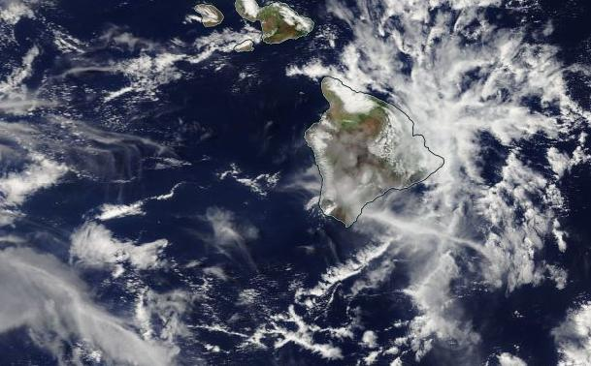
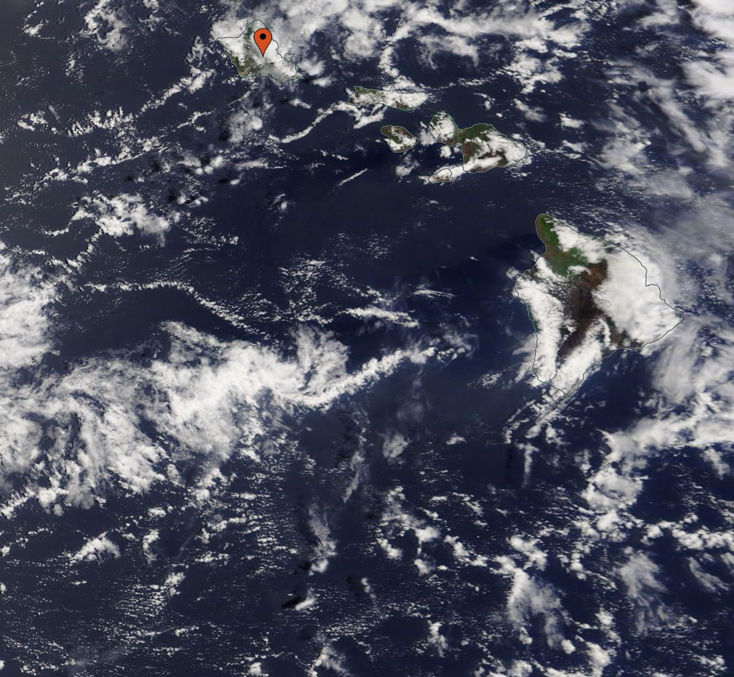
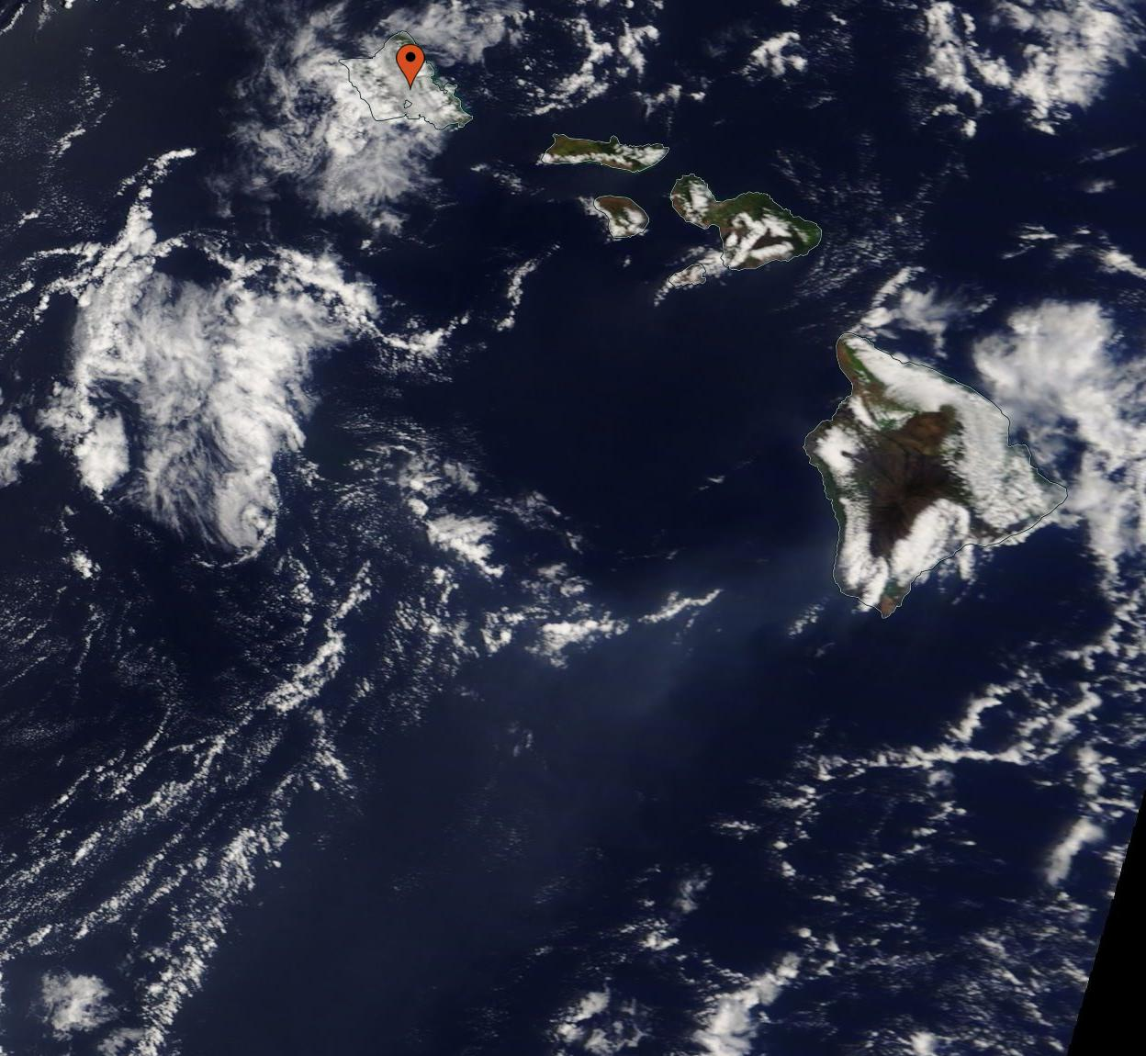
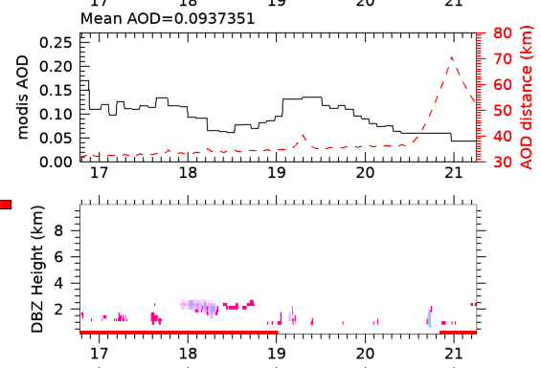
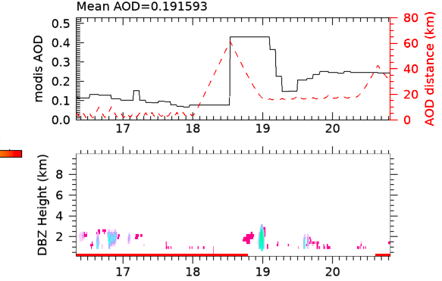
Differences in Precipitation from Cloudstat Downstream from Active Marine Volcanos
Jay Mace, Sally Benson, and Makenzie White
Question: Is there a difference in precipitation clouds using Cloudstat when high and low aerosol concentrations are present downstream of marine volcanos?
Results
Introduction
In Figure 1 and Image 2, there is no volcanic activity downstream from Kilauea. In the image, there is no sulfate stream on Worldview. When compared with the Cloudstat information from the same day, there is a very low level of Aerosol Optical Depth (AOD). This means that the clouds are small in depth comparison.
In Figure 2 and Image 3, there is volcanic activity with Kilauea and this is evident in the Worldview image and in the AOD results. The AOD changes from low to high around the 18.5 N latitude line. This shows that the clouds in this area have a larger AOD due to the plume from Kilauea.
Volcanos release Sulfates into the atmosphere, and it can affect the microphysics of clouds downstream of these volcanos
The different microphysics create a difference in the AOD (aerosol optical depth)
This information is gathered using the A-Train overpass data and Worldview
When aerosol levels are high due to the volcano plume, it is visible on Worldview as a light blue film, as shown in this photo
Image 2: Shows the Worldview image of Kilauea on July 9th, 2014, with no plume visible.
Image 3: Shows the aerosol plume downstream of Kilauea via Worldview on June 6th, 2014
Image 1: Shows the aerosol plume downstream of Kilauea on June 29th, 2014
Method
We only analyze data during daytime
From MERRA-2, use the 1 hour time averaged single level diagnostics (M2T1NXSLV), to find the 850 mb winds closest in time to the cloudsat overpass. Use the location 2 degrees South and 2 degrees East from the volcano to get the wind vector that will orient the sample area downstream from the volcano. The sample area is a rectangle with a short side (500 km) and the long side (1500 km) oriented along the wind vector. The cloudsat track that crosses the sample area is used to analyze the aerosol optical depth.
The aerosol optical depth comes from the MODIS Joint Atmosphere Product (MYDATML2).
The cloudsat radar reflectivity comes from 2B-GEOPROF.P1_R05
Figure 1: Shows DBZ Height and AOD of clouds downstream of Kilauea on July 9th , 2014, with a low overall AOD
Figure 2: Shows the DBZ Height and AOD downstream of Kilauea on June 6th, 2014, with a low to high overall AOD due to a plume.
Bibliography
Grosvenor, D. P., Sourdeval, O.,Zuidema, P., Ackerman, A., Alexandrov, M. D., Bennartz, R., et al. (2018). Remote sensing of droplet number concentration in warm clouds: A review of the current state of knowledge and perspectives. Reviews of Geophysics, 56, 409–453. https://doi.org/10.1029/2017RG000593
Latham J, Gadian A, Fournier J, Parkes B, Wadhams P, Chen J. 2014 Marine cloud brightening: regional applications. Phil. Trans. R. Soc. A 372: 20140053. http://dx.doi.org/10.1098/rsta.2014.0053
Remer, L. A., Kaufman, Y. J., Tanré, D., Mattoo, S., Chu, D. A., Martins, J. V., Li, R.-R., Ichoku, C., Levy, R. C., Kleidman, R. G., Eck, T. F., Vermote, E., & Holben, B. N. (2005). The MODIS Aerosol Algorithm, Products, and Validation, Journal of the Atmospheric Sciences, 62(4), 947-973.
Gelaro, R., McCarty, W., Suárez, M. J., Todling, R., Molod, A., Takacs, L., Randles, C. A., Darmenov, A., Bosilovich, M. G., Reichle, R., Wargan, K., Coy, L., Cullather, R., Draper, C., Akella, S., Buchard, V., Conaty, A., da Silva, A. M., Gu, W., Kim, G., Koster, R., Lucchesi, R., Merkova, D., Nielsen, J. E., Partyka, G., Pawson, S., Putman, W., Rienecker, M., Schubert, S. D., Sienkiewicz, M., & Zhao, B. (2017). The Modern-Era Retrospective Analysis for Research and Applications, Version 2 (MERRA-2), Journal of Climate, 30(14), 5419-5454.
Marchand, R., Mace, G. G., Ackerman, T., & Stephens, G. (2008). Hydrometeor Detection Using Cloudsat—An Earth-Orbiting 94-GHz Cloud Radar, Journal of Atmospheric and Oceanic Technology, 25(4), 519-533.
McCoy, I. L., D. T. McCoy, er al., 2020: The hemispheric contrast in cloud microphysical properties constrains aerosol forcing. Proceedings of the National Academy of Sciences, 18998-19006, doi: 10.1073/pnas.1922502117.
Krüger, O., and H. Graßl, 2011: Southern Ocean phytoplankton increases cloud albedo and reduces precipitation, Geophysical Research Letters, 38, L08809, DOI: 10.1029/2011GL047116
Mace, G. G., and S. Avey, 2017: Seasonal variability of warm boundary layer clouds and precipitation properties in the Southern Ocean as diagnosed from A-Train data. Journal of Geophysical Res. Atmos., 122, 1015-1032, doi:10.1002/2016JD025348
Humphries, R. S., A. R. Klekociuk, R. Schofield, M. Keywood, J. Ward, and S. R. Wilson, 2016: Unexpectedly high ultrafine aerosol concentration above East Antarctic sea ice. Atmos. Chem. Phys. 16, 2185-2206, doi:10.5192/acp-16-2185-2016.
Mace, G. G., A. Protat, R. S. Humphries, S. P. Alexander, I. M. McRobert, J. Ward, P. Selleck, M. Keywood, 2020: Southern Ocean cloud properties derived from CAPRICORN and MARCUS data. Accepted, Journal of Geophysical Research, DOI: 10.1029/2020JD033368.

