Slide 1
Variables and Data Types
Programming for Environmental Sciences

Slide 2
Variables
A variable represents a memory location that is assigned a name.
The memory location contains a value.
We reference that value with the name assigned to that memory location.
We can visualize variables, their names, and their values as shown
amount | 36.84 | volume | 183.0
rate | 0.065 | total | 486.5
temp | 17.5 | info | 72

Slide 3
Variable Names
Each variable must have a different name.
Case sensitivity
case insensitive – uppercase and lowercase are equivalent
TEMP = temp
Fortran, IDL
case sensitive – uppercase and lowercase treated as distinct
TEMP not equal to temp
Python, R, unix, Matlab, passwords
Special characters

Slide 4
Variable Names
Rules
Fortran
Must start with a letter
After that, the rest of the name can contain only letters (a-z), digits (0-9) or underscore character _ (no blanks!)
Fortran 90 A variable name can be no longer than 31 characters.
Fortran77 6 characters
Python
Must start with a letter or an underscore
The remainder of your variable name may consist of uppercase and lowercase letters, numbers and underscores
Names are case sensitive
No length restriction

Slide 5
Variable Names
Good Variable Names
Someone else may try to use your code
Well thought out names reduce the need for extensive comments
Make names descriptive temp better than t
Use multiple words temp_celcius lwp_modis
Separate words with underscore
The longer the name the more likely you are to make a typo
All lower case

Slide 6
Scientific Notation
When a real number is very large or vary small, decimal notation does not work satisfactorily.
Decimal | Scientific | Exponential
3876000000 | 3.876X10⁹ | 0.3876e10
0.0000010053 | 1.0053X10⁻⁶ | 0.10053e-5
-8030000 | -8.03X10⁶ | -.803e7

Slide 7
Data Types
Data typing help tells the processor what to expect and the amount of memory space to reserve for what to expect.
A memory location can contain only one type of value
Integer
No fractional portion and no decimal point
Real
Contain a decimal point and may or may not have digits past the decimal point
Also called floating-point, float

Slide 8
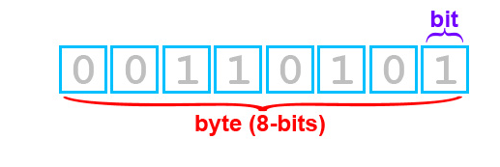
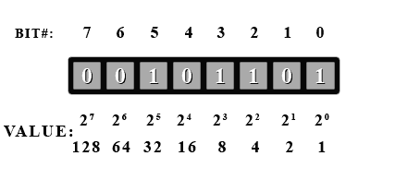
A little binary
00000000 = 0
00000001 = 1
00000010 = 2
00000011 = 3
00000100 = 4
00000101 = 5
11111111 = 255

Slide 9
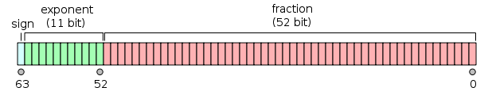
Data Types
Data Type | example | Storage size | Value range | Precision
Integer (short) | 32 | 2 bytes | -32,768 to 32,767
Integer (long) | 2e9 | 4 bytes | -2,147,483,648 to 2,147,483,647
Real | -15.45 | 4 bytes | 1.2E-38 to 3.4E+38 | 6 decimal places
Double | 3.1415926536 | 8 bytes | 2.3E-308 to 1.7E+308 | 15 decimal places
Character | V | 1 byte | 0 to 255
Logical | .TRUE. |  | .FALSE.
The memory format of a double floating point value

Slide 10
How to define in different languages
Explicit
Must declare every variable before you use it
Some languages let you choose, visual basic
REAL :: temperature, pressure Fortran90
Implicit
You can use variables without declaring them
You don't have to declare anything ahead of time, because in these languages variables don't have types, values have types, and variables are just nametags attached to values, therefore there's nothing to declare about the type of a variable in the absence of a value.
Python, IDL, etc

Slide 11
Truncation
When an arithmetic operation is performed using two real numbers, it’s intermediate result is a real value
Similarily, arithmetic operations between two integers yield an integer
Length=side*3.5 side is real, length is integer
The real result is stored in an integer
When the computer stores a real number in an integer variable, it ignores the fractional portion and stores only the whole number portion of the real number.
This type of rounding is called truncation

Slide 12
Computations with integers
Mean=(n1+n2)/2
All integers, result will be integer n1=2,n2=4,mean=3
N1=2, n2=3, mean=2 instead of 2.5, all integers
Ave=(n1+n2)/2 ave is real
The result of integer arithmetic is still integer, the result is stored in a real value.
Ave=(n1+n2)/2.0 all reals
With rounding, the result is the integer closest in value to the real number
With truncation, any decimal portion is dropped
15/8=1.875 rounded? Truncated?

Slide 13
Rounding Error
Roundoff error is the difference between an approximation of a number used in computation and its exact (correct) value.
Digital computers have size and precision limits on their ability to represent numbers
Certain numerical manipulations are highly sensitive to roundoff errors.
Large computations
Adding a large and small number

Slide 14
Rounding Error
Unfortunately, most decimal fractions cannot be represented exactly as binary fractions. A consequence is that, in general, the decimal floating-point numbers you enter are only approximated by the binary floating-point numbers actually stored in the machine.
The problem is easier to understand at first in base 10. Consider the fraction 1/3. You can approximate that as a base 10 fraction:0.3, or better 0.33 or still better 0.333 and so on. No matter how many digits you’re willing to write down, the result will never be exactly 1/3, but will be an increasingly better approximation of 1/3.
In the same way, no matter how many base 2 digits you’re willing to use, the decimal value 0.1 cannot be represented exactly as a base 2 fraction. In base 2, 1/10 is the infinitely repeating fraction
0.0001100110011001100110011001100110011001100110011...
Stop at any finite number of bits, and you get an approximation.

Slide 15
Mixed Mode
Some programming languages take the simple way out and prohibit any expressions involving values of different data types and then provide special type conversion functions. This is called strong typing and such languages are called strongly typed.
The C language is not strongly typed and instead infers the required type conversions from the context.

Slide 16
Time – number of seconds
To search within a time array, you need something monotonically increasing and unique
Seconds
Choose a base time
1/1/1970 0:0:0 ,midnight, 1/1/1993 0:0:0, file start
A time offset is an amount of time subtracted from or added to the base time to get the time value of the data point
sbsmetM1.b1.20110425.000000.cdf
base_time = 1303689600
time_offset = 0, 60, 120, 180, 240, 300, 360, 420, 480, 540, 600, 660, 720, 780, 840, 900, 960, 1020, 1080, 1140, 1200, 1260, 1320, 1380, 1440, 1500,

Slide 17
Time – fractional day
Fractional Day (julian day)
The Julian calendar, established by Julius Caesar in the year 45 BCE, the calendar specifies that every 4 years is a leap year, except if the year ends in a "00" then it is not a leap year, unless it is also divisible by 400 (in which case it is a leap year).
Go to IDL program

Slide 18
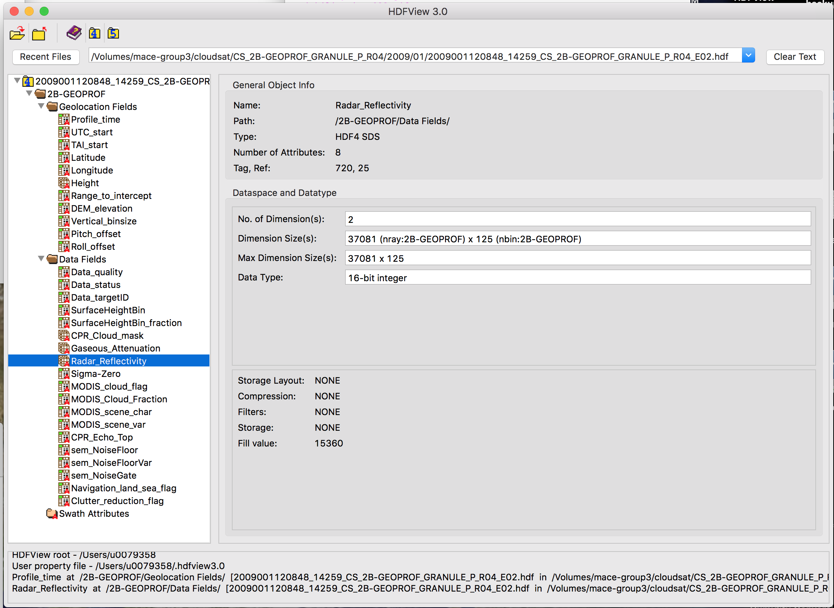

Slide 19
Overflow and Underflow
Overflow
Result too large to store in the computer
Underflow
The exponent of the result is too small to store in the computer
If you get exponent underflow or overflow errors when you run your programs, you need to examine the magnitude of the values you are using.
Go to IDL program

