Slide 1
Class 8:
Algorithms

Slide 2
Discussion Overview
This discussion is to provide a foundation of understanding for what algorithms are and how they can be used programmatically.
Define algorithms
Review examples
Understanding performance
Consider complexity
Tips and tricks of sound algorithms

Slide 3
Reading Assignment
Big O
Travelling salesman complexity

Slide 4
Homework Review
Questions or comments?

Slide 5

Al Gore Rhythm

Slide 6
Algorithm: defined
A procedure for solving a mathematical problem (as of finding the greatest common divisor) in a finite number of steps that frequently involves repetition of an operation;
broadly : a step-by-step procedure for solving a problem or accomplishing some end especially by a computer
- Merriam-Webster, Online dictionary

Slide 7
Algorithm
Algo – Greek, from algos, meaning pain. But this cognate is not related to the word.
Algo – Spanish, meaning something.
n.1690s, from French algorithme, refashioned (under mistaken connection with Greek arithmos "number") from Old French algorisme "the Arabic numeral system" (13c.), from Medieval Latin algorismus, a mangled transliteration of Arabic al-Khwarizmi "native of Khwarazm," surname of the mathematician whose works introduced sophisticated mathematics to the West (see algebra ). The earlier form in Middle English was algorism(early 13c.), from Old French.
Online Etymology Dictionary, © 2010 Douglas Harper

Slide 8
Common Algorithm Categories
Search
Sort
Encryption
Compression
Graph
Flock
Shuffle (inverse of sort)

Slide 9
Sudoku: an emerging field

Slide 10
Algorithm vs functions
If algorithms are indeed
“a step-by-step procedure for solving a problem or accomplishing some end, especially by a computer”
are we just saying that functions or procedures in code are the same as algorithms?
Not really, because a function is a set of operations in code. It is only the physical representation of the algorithm. The algorithm itself is almost always an abstract concept which describes a solution.
Ergo, do all algorithms necessitate a solution to a problem?

Slide 11
Common Algorithm Approaches
The classification means very little, other than to illustrate the many ways any particular problem can be approached.
In other words, the “type” of algorithm depends on how you frame the problem to solve. In this context, the approach may be a variant of common techniques, such as these classes:
Recursive algorithms (central to most algorithms)
Divide and conquer algorithms
Brute force algorithms
Branch and bound algorithms
Greedy algorithms
Dynamic programming algorithms

Slide 12
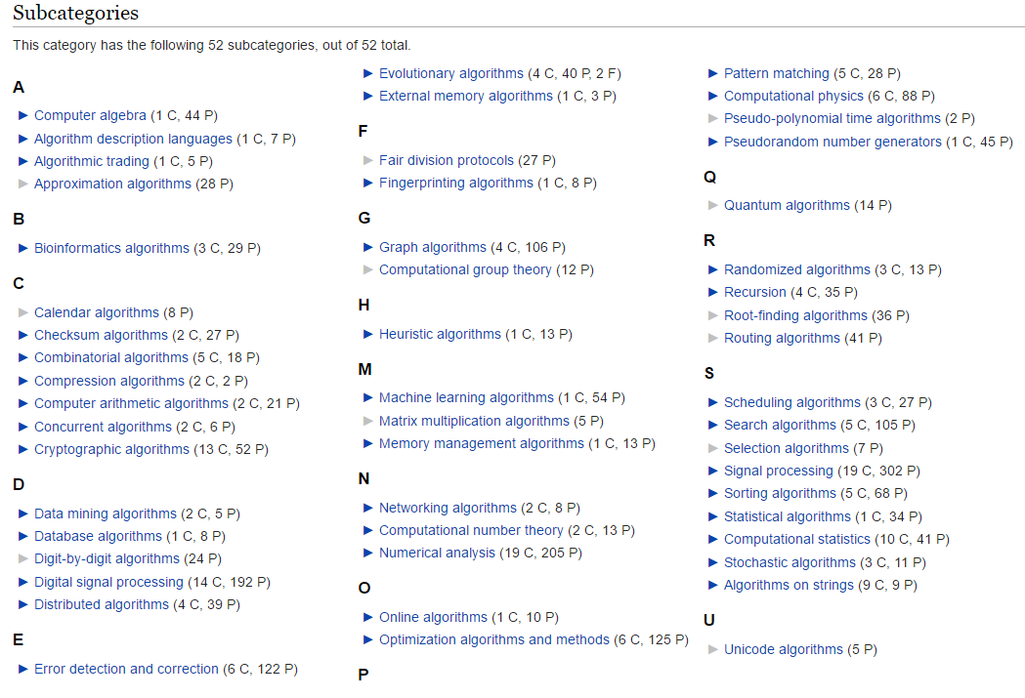
Categories
Wikipedia, https://en.wikipedia.org/wiki/Category:Algorithms

Slide 13
Algorithm Examples
The Bubble Sort Algorithm
A simple sorting algorithm that repeatedly steps through the list to be sorted, compares each pair of adjacent items and swaps them if they are in the wrong order. The pass through the list is repeated until no swaps are needed, which indicates that the list is sorted.
https://en.wikipedia.org/wiki/Bubble_sort
Let’s sort the set of numbers [3,5,1,2,4] on the board:
https://algoderp.herokuapp.com/sorting

Slide 14
Efficiency
The efficiency of an algorithm is almost always referring to its ability to arrive at a correct solution in the smallest number of steps possible. Consider this task with a cost analysis approach, where “cost” represents an operation of “work” or instruction:
#Find position of first number > 123 in array n = len(data) i = 0 for d in data: if d > 123: break i = i + 1 | #keep track of “work” c1 c2 c3 c4

Slide 15
Algorithm “cost” analysis
Total cost = c1 + c2 + (i * c3) + (i * c4)
Best case:
If first number in data is > 123, our total cost is 4
Worst case:
All numbers are less than 123! So cost is 2 + n + n.
What’s the average cost of a random series of numbers from 0 to 200 with length of 1,000,000?

Slide 16
Competing interpretations
This can’t be answered sufficiently because we have framed the question incorrectly! Cost has become a function of the length of our list, which does not indicate how the algorithm responds as the list increases.
Be careful not to mix these concepts:
Performance (dependent on computer resources and other external factors)
Complexity
Efficiency
Because each step takes time, this is also a representation of an algorithm’s total time to execute. However, do not confuse time with efficiency and complexity. For that we need to consider a technique that measures how well an algorithm can solve a problem as its input increases in size.

Slide 17
Understanding Big O
Taken from: http://web.mit.edu/16.070/www/lecture/big_o.pdf
Big O notation (with a capital letter O, not a zero), also called Landau's symbol, is a symbolism used in complexity theory, computer science, and mathematics to describe the asymptotic behavior of functions. Basically, it tells you how fast a function grows or declines.
**Complexity affects performance but not the other way around.

Slide 18
Understanding Big O
How efficient is an algorithm or piece of code?
Efficiency covers lots of resources, including:
CPU (time) usage
memory usage
disk usage
network usage
All are important but we will mostly talk about time complexity (CPU usage)

Slide 19
Introduction to Big O
Here is a surprisingly good read on the topic:
http://stackoverflow.com/questions/3255/big-o-how-do-you-calculate-approximate-it
Very good resource with python examples:
https://interactivepython.org/runestone/static/pythonds/index.html

Slide 20
Complexity as function of growth
Big O notation | Growth Order
O(1) | Constant
O(log(n)) | Logarithmic
O(n) | Linear
O(2log(n)) | “n log n”
O(n^2) | Quadratic
O(n^3) or O(n^i) | Cubic / Polynomial
O(2^n) or O(n!) or … | exponential / factorial / bigness

Slide 21
Let n be the length of an array
n | log(n) | nlog(n) | n^2 | n^3 | 2^n | n!
2 | 1 | 2 | 4 | 8 | 4 | 2
4 | 2 | 8 | 16 | 64 | 16 | 24
8 | 3 | 24 | 64 | 512 | 256 | 40320
16 | 4 | 64 | 256 | 4096 | 65536 | 20922789888000
32 | 5 | 160 | 1024 | 32768 | 4294967296 | …
128 | 7 | 896 | 16384 | 2097152 | 3.40282E+38 | …
1024 | 10 | 10240 | 1048576 | 1073741824 | 1.8E+308 | …
65536 | 16 | 1048576 | 4294967296 | 2.81475E+14 | Not gonna happen | …

Slide 22
Big O notation
Big O does not measure the performance of an algorithm. Rather, it expresses how well an algorithm scales with increased input size.
It is the asymptotic relationship of the function as the size of input approaches infinity. In this regard, the use of Big O notation is a comment on an algorithms’ bounded limits, where Big O refers to the limits of the upper bounds. Big Theta refers to the lower bounds.
“In computational complexity theory, asymptotic computational complexity is the usage of asymptotic analysis for the estimation of computational complexity of algorithms and computational problems, commonly associated with the usage of the big O notation.”
https://en.wikipedia.org/wiki/Asymptotic_computational_complexity

Slide 25
Sorting Algorithms
Back to the Bubble Sort. What Big O complexity does it have?
def bubbleSort(alist): for passnum in range(len(alist)-1,0,-1): for i in range(passnum): if alist[i]>alist[i+1]: temp = alist[i] alist[i] = alist[i+1] alist[i+1] = temp alist = [3,5,2,4,1] bubbleSort(alist) #note nothing was returned | First loop is n-1 Second loop is n -1 through n – n C C C C So total work is expressed as average/worst case number of iterations: O(n^2) Best case is Ω(n) (omega n). That is, the list was already sorted, so one pass (linear) was needed.

Slide 26
Searching Algorithms
Back to the three lists of times from Class 3.
for a in list1: for b in list2: for c in list3: if a == b and b == c: print 'found a match!' | First loop is len(list1) = n1 Second loop is len(list2) = n2 Third loop is len(list3) = n3 We have n1 * n2 * n3. The approximation of complexity might be to take the max of [n1, n2, n3] and cube it. Therefore, we could feel safe that the growth of the upper bounds of this algorithm can be expressed as O(n^3). It is cubic. However, if list 1 was length 1 (or even 2) what’s really going on here?

Slide 27
Care to play 20 questions? Go fish?
If we have a list of one million (1,000,000) numbers sorted and we want to find the position of a number in that list, can you do it in 20 questions or less?
Number to find is 543,489,036,109
You could try to guess randomly: Is it position 433,802 ? (go fish) Or maybe you get lucky!
“Are you my mother?”
You could frame the problem using a O(logn) algorithm.
Reframe the question “are you exactly here?” to “are you left or right of here?”

Slide 28
Searching Algorithms
There are many ways to search. Two simple ones using different approaches are:
Linear search match = 123 for d in data: if d == match: break | Binary search def binarySearch(alist, item): if len(alist) == 0: return False else: midpoint = len(alist)//2 if alist[midpoint]==item: return True else: if item<alist[midpoint]: return binarySearch(alist[:midpoint],item) else: return binarySearch(alist[midpoint+1:],item) testlist = [0, 1, 2, 8, 13, 17, 19, 32, 42,] print(binarySearch(testlist, 3))

Slide 29
Binary Search is O(logn)
Comparisons | Approximate number of items left
1 | n/2
2 | n/4
3 | n/8
4 | n/16
i | n/2^i
Whereby, solving for i in n/2^i = 1 will give i = logn. Therefore we can state that binary search is a O(logn) complexity.

Slide 30
Homework #8
Find the height of dew point by lifting a parcel of air using DALR.
Found here:
http://www.inscc.utah.edu/~u0079358/atmos6910/Class_8/Homework_8.docx

Slide 31
Example of rising parcel to dew point
DALR = 9.8 C / 1000m, assume dew point rate = 2 C / 1000m
Hints here: http://www.theweatherprediction.com/habyhints2/502/
Height AGL (m) | Parcel T | Dew Point T | Delta T
0 | 23.5 | 13.1 | 10.4
100 | 22.52 | 12.9 | 9.62
200 | 21.54 | 12.7 | 8.84
300 | 19.58 | 12.5 | 8.06
1300 | 10.76 | 10.5 | 0.26
1400 | 9.78 | 10.3 | -0.52

