Slide 1
Control structures

Slide 2
Relational Operators
Relational Operator Interpretation
.EQ. Equal to
.NE. Not equal to
.LT. Less than
.LE. Less than or equal to
.GT. Greater than
.GE. Greater than or equal to
Compound logical expression
Logical operators .OR. .AND. .NOT.

Slide 3
Logical Operators
A B .NOT. A A.AND.B A.OR.B
False False True False False
False True True False True
True False False False True
True True False True True
Clouds that are thin and high
Clouds that are thin or high
Cloud base height, cloud thickness

Slide 4
Relational and Arithmetic Operator Precedence
Priority | Operation | Order
1 | Parentheses | Innermost first
2 | Exponentiation | Right to left
3 | Multiplication and Division | Left to right
4 | Addition and Subtraction | Left to right
5 | Relational Operators | Left to right
6 | .NOT. | Left to right
7 | .AND. | Left to right
8 | .OR. | Left to right

Slide 5
IF
IF (logical expression) THEN I
statement 1
.
.
.
statement n
END IF
IF (logical expression 1) THEN
statement 1
…
statement n
IF (logical expression 2) THEN
statement n+1
…
statement m
END IF
statement m+1
…
statement p
END IF
statement q

Slide 6
ELSE
IF (logical expression 1) THEN
statement 1
…
statement m
ELSE IF (logical expression 2) THEN
statment m+1
...
statment n
ELSE IF (logical expression 3) THEN
statement n+1
...
statement p
ELSE
statement p+1
...
statement q
END IF
IF (logical expression 1) THEN
statement 1
…
statement n
ELSE
statement n+1
...
statment m
END IF

Slide 7
Self-Test
A = 2.2 B = -1.2 i=5 DONE=.TRUE.
A .LT. B | A – B .GE. 6.5
i .NE. 5 | A + B .GE. B
.NOT. (A .EQ. 2*B) | i .LE. i - 5
(A .LT. 10.0) .AND. (B .GT. 5.0) | (ABS (i) .GT. 2) .OR. DONE
If time is greater than 5.0, increment time by 0.5
If the natural logarithm of X² is greater than or equal to 3, set TIME equal to 0 and add X to SUM.
If DIST is less than 50 or TIME is greater than 10, increment TIME by 1. Otherwise, increment TIME by 0.5
If DIST is greater than 100, increment TIME by 2. If DIST is between 50 and 100 (including 100), increment TIME by 1. Otherwise, increment TIME by 0.5.

Slide 8
While Loop
DO WHILE ( condition )
statement 1
…
statement m
END DO
statement p

Slide 9
Iterative Loop
DO index = initial, limit, increment
statement 1
…
statement n
END DO
Statement n+1

Slide 10
Nested loops
DO i=1,5
DO j=1,8
DO k=2,10,2
…..
END DO
END DO
END DO
DO j=1,5
DO j=1,8
...
END DO
END DO
DO i=1,5
DO k=1,8
…
END DO
DO k=2,10,2
…
END DO
END DO
DO i=1,5
DO j=1,8
...
i=i+1
END DO
END DO

Slide 11
WHERE (WHICH, FIND)
cloud_base=[4,7,9,2,10,9,10] units=kilometers
0 1 2 3 4 5 6
result=where(cloud_base GE 8.0,count)
count=4
result=[2,4,5,6]
cloud_base_high=cloud_base[result]
cloud_base_high=[9,10,9,10]

Slide 12
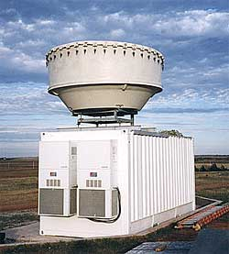
Millimeter cloud radar
Cloud radars – cloud properties and evolution
Opperating frequencies 24 to 110 GHz
Wavelengh range 1mm to 1.11 cm
Ten times shorter than those use in conventional radars (NEXRAD)
Temporal resolution 1 to 10 seconds
Range resolution 4 to 60 meters
Maximum detection range 14 to 20 km
Opperate pointing to the zenith or scanning
Shorter wavelenth sensitive to smaller particles
Can be attenuated by clouds and precipitation

Slide 13
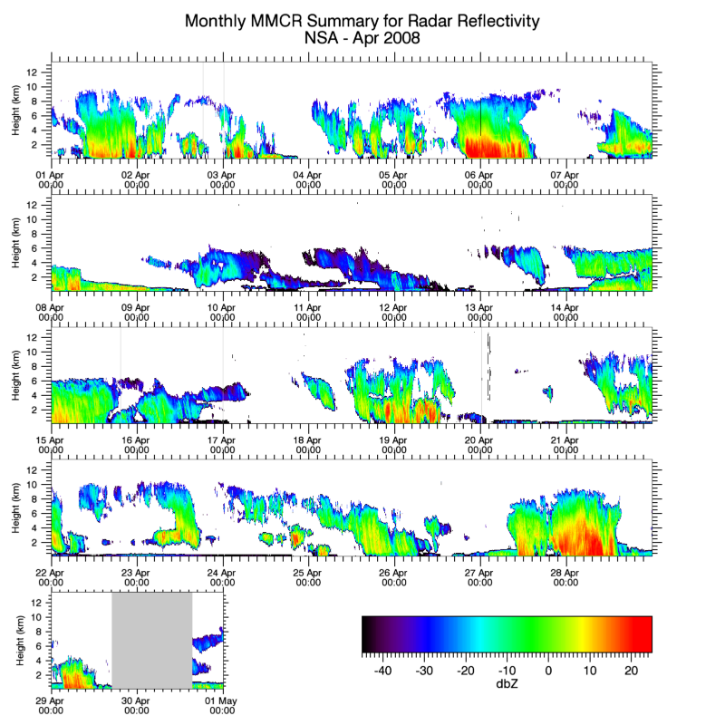
Cloud
Clear
missing

Slide 14
netcdf nsammcrMergedMomentsC1.c1.20080405.000036 {
dimensions:
time = 14013 ;
nheights = 149 ;
variables:
int base_time ;
base_time:long_name = "Base time in Epoch" ;
base_time:units = "seconds since 1970-01-01 00:00:00 00:00" ;
double time_offset(time) ;
time_offset:long_name = "Time since Base Time" ;
time_offset:units = "seconds" ;
float Heights(nheights) ;
Heights:long_name = "range gate height above ground" ;
Heights:units = "meters" ;
short ReflectivityBestEstimate(time, nheights) ;
ReflectivityBestEstimate:long_name = "MMCR radar reflectivity" ;
ReflectivityBestEstimate:units = "DbZe->(float((*))/100." ;
short MeanDopplerVelocity(time, nheights) ;
MeanDopplerVelocity:long_name = "MMCR Doppler Velocity" ;
MeanDopplerVelocity:units = "m/s->(float(*)/1000.)" ;
short SpectralWidth(time, nheights) ;
SpectralWidth:long_name = "MMCR Spectrum Width" ;
SpectralWidth:units = "m/s->(float(*)/1000.)" ;
short SignaltoNoiseRatio(time, nheights) ;
SignaltoNoiseRatio:long_name = "MMCR Mode used in a given data point" ;
SignaltoNoiseRatio:units = "db" ;
SignaltoNoiseRatio:comment1 = "1 - boundary layer (stratus)" ;
SignaltoNoiseRatio:comment2 = "2 - sensitive (cirrus)" ;
SignaltoNoiseRatio:comment3 = "4 - robust (precip)" ;
short ModeID(time, nheights) ;
// global attributes: :global_att1 = "This file merges three MMCR modes onto the time-space grid of the general
mode" ;
:global_att2 = "using confident clutter and artifacts flags from robust,general,cirrus modes" :global_att3 = "in that order. The values are placed on the general mode" ;
:global_att4 = "grid using the nearest neighbor of the point." ;}

Slide 15
One MMCR Profile
IDL> print, reflect[10,*] -9999.00 -9999.00 -9999.00 -9999.00 -9999.00 -9999.00 -3192.00 -2521.00 -2087.00 -2315.00 -3711.00 -9999.00 -9999.00 -9999.00 -9999.00 -9999.00 -9999.00 -9999.00 -9999.00 -9999.00 -9999.00 -9999.00 -9999.00 -9999.00 -9999.00 -9999.00 -9999.00 -9999.00 -9999.00 -9999.00 -9999.00 -9999.00 -9999.00 -9999.00 -9999.00 -9999.00 -9999.00 -9999.00 -9999.00 -9999.00 -9999.00 -9999.00 -9999.00 -9999.00 -9999.00 -9999.00 -9999.00 -9999.00 -9999.00 -9999.00 -9999.00 -9999.00 -9999.00 -9999.00 -9999.00 -9999.00 -9999.00 -9999.00 -9999.00 -9999.00 -9999.00 -9999.00 -9999.00 -3171.00 -2774.00 -2872.00 -2874.00 -3191.00 -3294.00 -3650.00 -9999.00 -9999.00 -9999.00 -9999.00 -9999.00 -9999.00 -9999.00 -9999.00 -9999.00 -9999.00 -9999.00 -9999.00 -9999.00 -9999.00 -9999.00 -9999.00 -9999.00 -9999.00 -9999.00 -9999.00 -9999.00 -9999.00 -9999.00 -9999.00 -9999.00 -9999.00 -9999.00 -9999.00 -9999.00 -9999.00 -9999.00 -9999.00 -9999.00 -9999.00 -9999.00 -9999.00 -9999.00 -9999.00 -9999.00 -9999.00 -9999.00 -9999.00 -9999.00 -9999.00 -9999.00 -9999.00 -9999.00 -9999.00 -9999.00 -9999.00 -9999.00 -9999.00 -9999.00 -9999.00 -9999.00 -9999.00 -9999.00 -9999.00 -9999.00 -9999.00 -9999.00 -9999.00 -9999.00 -9999.00 -9999.00 -9999.00 -9999.00 -9999.00 -9999.00 -9999.00 -9999.00 -9999.00 -9999.00 -9999.00 -9999.00 -9999.00 -9999.00 -9999.00 -9999.00

Slide 16
Data Analysis
Sally, can you make the vertical frequency distributions of cloud occurrence as a function of maximum reflectivity like we discussed? Use upper thresholds of -25, -15, -5, +5 and +15 and all dBZ. Do them for the individual months of 2008 from January through April and then for the individual months of 2010 for February through April and then do a combined February through April frequency distribution for each year.

Slide 17
Readings and Homework
http://www.inscc.utah.edu/~u0079358/atmos6910/Class_5

