Slide 1
Class 4:
Input and Output, part II

Slide 2
The Lecture of Today
Continued overview of basic input and output (I/O or IO) techniques as it relates to Atmospheric Science programming and how to manage competing techniques to arrive at a practical solution.
Discussion of more file formats.
Examples of working with common ATMOS data types.
Deconstruct the thought process with approaching data tasks.

Slide 3
Reading Assignment
Scales, offsets, compression.

Slide 4
Homework Review
Questions or comments?
Let’s go over an example of “match_items_in_three_lists.py”

Slide 5
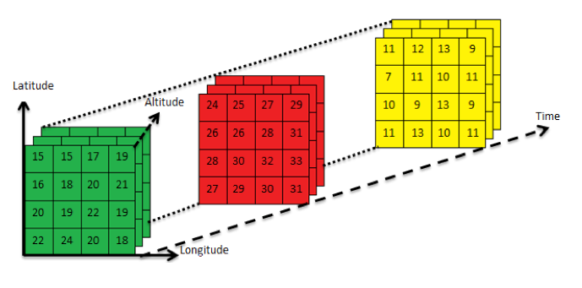
NetCDF 4 dimension example
A grid of relative humidity for multiple times each at multiple levels.
Such as, latitude, longitude, pressure level, time.

Slide 6
ncdump - h mtmet.nc
netcdf mtmet {
dimensions:
time = 25920 ;
variables:
int date(time) ;
date:units = "epoch seconds since Jan 1, 1970 00:00:00z" ;
float temp(time) ;
temp:units = "c degrees" ;
float rh(time) ;
rh:units = "percentage" ;
float wind_speed(time) ;
wind_speed:units = "meters per second" ;
float wind_direction(time) ;
wind_direction:units = "direction degrees" ;
float wind_gust(time) ;
wind_gust:units = "meters per second" ;
// global attributes:
:description = "Time series for Mountain Meteorology (MTMET) station on University of Utah campus." ;
:location = "Salt Lake City, Utah" ;
:latitude = "40.766573" ;
:longitude = "-111.828211" ;
}

Slide 7
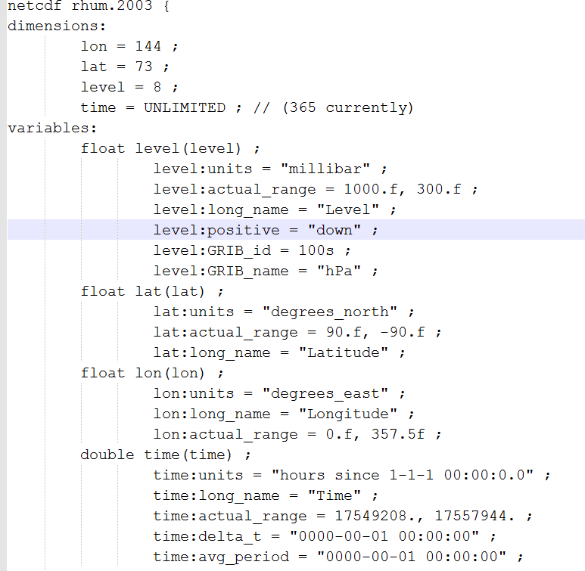
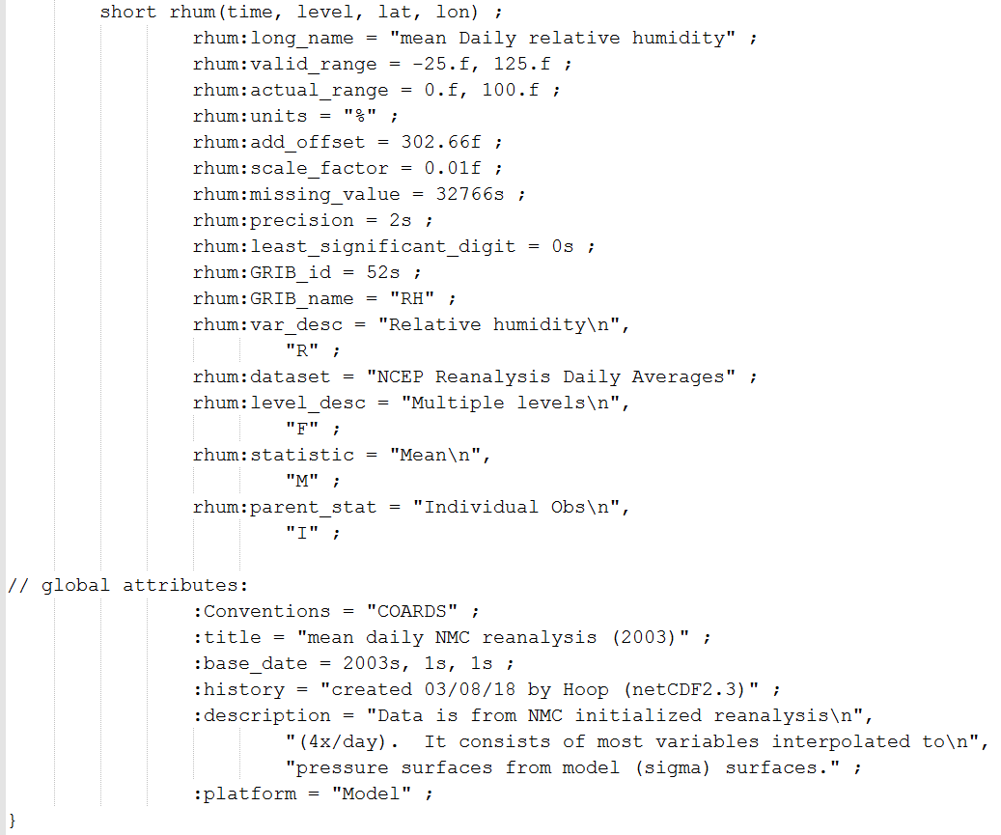
ncdump -h rhum.2003.nc

Slide 8
Example: The right slice(s)
Your advisor wants to summarize a basic seasonal signature for a 5 degree by 5 degree box centered over Salt Lake City for 1000 hPa and 500 hPa levels. The data needs to be grouped by 4 distinct periods of JFM, AMJ, JAS, OND. You’ll use the 2003 RH NetCDF file mentioned.
How do we approach the problem?
Why are we doing this? … What is the desired output? … What tools are we using to extract these values?

Slide 9
Example
Let’s stop and think about our thought process—thinking about thinking, or cognitive thinking.
In other words, before we starting thinking about how to solve the problem, let’s make sure we’re even thinking about the problem properly.
In social sciences, we call this “Framing the Problem.” Or if already framed, we might need to “reframe.”

Slide 10
Frame It
What’s the problem or task at hand?
We might say:
“There’s a year of RH data that needs to be organized by season for a small region around SLC for two pressure levels.”

Slide 11
Frame It
What am I doing?
“I need to organize a subset of RH data for 2003 and group it by some defined seasons. I need to do this for two pressure levels.”
Why?
“Not entirely sure yet, but I suspect because we need to analyze that subset of data for something really important.”

Slide 12
Example: free-form
Do I need to address how the data is going to be “summarized”?
Do I need to keep this data in NetCDF (the same file format)?
Should I write out a separate file for each pressure level by each season? That would give me 4 * 2 = 8 files.

Slide 13
Revisit: step 1
Your advisor wants to summarize a basic seasonal signature for a 5 degree by 5 degree box centered over Salt Lake City for 1000 hPa and 500 hPa levels. The data needs to be grouped by 4 distinct periods of JFM, AMJ, JAS, OND. You’ll use the 2003 RH NetCDF file mentioned.
I don’t know what “summarize a basic seasonal signature” means exactly, but I know I need to group data into specific time periods.
My first thought is to create separate files for those groups.
Maybe for the JFM, AMJ, JAS, OND periods mentioned

Slide 14
Revisit: step 2
Your advisor wants to summarize a basic seasonal signature for a 5 degree by 5 degree box centered over Salt Lake City for 1000 hPa and 500 hPa levels. The data needs to be grouped by 4 distinct periods of JFM, AMJ, JAS, OND. You’ll use the 2003 RH NetCDF file mentioned.
I need to get 5 degrees around SLC, so 2.5 degrees in every direction to make my “query window”, or “bounding box” or “extents” or whatever I want to call it… I know what I mean.
So that requires what?… the same files I was thinking about as output would work. I just need to know the dimensions of X and Y, or my longitude and latitude.
Ah, wait… I need to add two levels of RH values, so is that a third dimension?
hmm, this feels confusing. Hold on… Let me rethink this…

Slide 15
Revisit: step 3
Your advisor wants to summarize a basic seasonal signature for a 5 degree by 5 degree box centered over Salt Lake City for 1000 hPa and 500 hPa levels. The data needs to be grouped by 4 distinct periods of JFM, AMJ, JAS, OND. You’ll use the 2003 RH NetCDF file mentioned.
… coffee break …
OK. I think 4 files will work well. One for each season, with 2 levels.
Let’s write some basic pseudo code as sub tasks so I have a skeleton or substrate or scaffolding to work about or on… or whatever. I know what I mean.

Slide 16
Revisit: step 4
Your advisor wants to summarize a basic seasonal signature for a 5 degree by 5 degree box centered over Salt Lake City for 1000 hPa and 500 hPa levels. The data needs to be grouped by 4 distinct periods of JFM, AMJ, JAS, OND. You’ll use the 2003 RH NetCDF file mentioned.
Open file, yeah, obviously I have to open the NetCDF file.
Find latitude and longitude grid by grabbing those two arrays first
Find the index positions of what box of data I want
Using the lat/lon (positions, indexes) start iterating through the rh data
Get that slice of data and write it to the…@!#
Ah shizizzle. I forgot I need to open some files to write to. Maybe I should do that first. But I don’t know the box/extent of the data yet, so how can I even start creating the new files? Should I even create the new files? What does that get me?

Slide 17
Revisit: step 5
Your advisor wants to summarize a basic seasonal signature for a 5 degree by 5 degree box centered over Salt Lake City for 1000 hPa and 500 hPa levels. The data needs to be grouped by 4 distinct periods of JFM, AMJ, JAS, OND. You’ll use the 2003 RH NetCDF file mentioned.
(inserted)
Find lat/lon index values and create a new NetCDF file.
I should probably do that in a function.

Slide 18
Revisit: step 6
Your advisor wants to summarize a basic seasonal signature for a 5 degree by 5 degree box centered over Salt Lake City for 1000 hPa and 500 hPa levels. The data needs to be grouped by 4 distinct periods of JFM, AMJ, JAS, OND. You’ll use the 2003 RH NetCDF file mentioned.
For each date, compare the times and write my extracted segment of data to the proper new file
Oh! And do that for each pressure level, so nest that in there.
Close the files after I’m finished.
That’s it.

Slide 19
Question
What’s the most common sub task I had to perform to get this data sorted and subsetted?

Slide 20

“Is this equal to that?”

Slide 21
Let’s look at this example
terminal

Slide 22
Revision
And then your advisor says, “We need to do this for the last 1000 years of data too.”
Would we change our first approach in any way?

Slide 23
Grib Time: Come and get it
Gribs have these practical defining characteristics
Store 2d slabs of data for a single parameter/varaible (e.g., 2m air temperature)
Self describing. The headers are messages in each segment of data.
Internal packing and compression for each variable.
Sequential byte range positions for each variable.
Well supported and used everywhere.

Slide 24
GRIB Defined
GRIB (GRIdded Binary or General Regularly-distributed Information in Binary form[1]) is a concise data format commonly used in meteorology to store historical and forecast weather data. It is standardized by the World Meteorological Organization's Commission for Basic Systems, known under number GRIB FM 92-IX, described in WMO Manual on Codes No.306.
https://en.wikipedia.org/wiki/GRIB

Slide 25
Grib indexes
All grib files can have indexes generated for them. This requires a full inspection of each file to generate it. Files will often have .idx as a suffix.
fh.0003_tl.press_gr.0p50deg
fh.0003_tl.press_gr.0p50deg.idx
such as:
ftp://tgftp.nws.noaa.gov/SL.us008001/ST.opnl/

Slide 26
wgrib2 filename |more
1:0:d=2016102400:UGRD:planetary boundary layer:3 hour fcst:
2:168441:d=2016102400:VGRD:planetary boundary layer:3 hour fcst:
3:337019:d=2016102400:VRATE:planetary boundary layer:3 hour fcst:
4:513215:d=2016102400:GUST:surface:3 hour fcst:
5:687651:d=2016102400:HGT:1 mb:3 hour fcst:
6:837756:d=2016102400:TMP:1 mb:3 hour fcst:
7:906706:d=2016102400:RH:1 mb:3 hour fcst:
8:953992:d=2016102400:UGRD:1 mb:3 hour fcst:
9:1027411:d=2016102400:VGRD:1 mb:3 hour fcst:
10:1099976:d=2016102400:O3MR:1 mb:3 hour fcst:
11:1216352:d=2016102400:HGT:2 mb:3 hour fcst:
12:1366512:d=2016102400:TMP:2 mb:3 hour fcst:
13:1435955:d=2016102400:RH:2 mb:3 hour fcst:
14:1466579:d=2016102400:UGRD:2 mb:3 hour fcst:

Slide 27
Grib record details
280:46296153:d=2016102400:TMP:2 m above ground:3 hour fcst:
where
280 is the record number (they start at 1)
46296153 is the first byte of this record in the file
d=2016102400 is the date and runtime of the model. Oct 24, 2016 00z run.
TMP is the variable
2 m above ground is the vertical reference
3 hour fcst is the forecast hour from the base model runtime

Slide 28
GRIB files
http://www.ftp.cpc.ncep.noaa.gov/wd51we/wgrib2/tricks.wgrib2
There are some interesting ways to work with these files, such as:
wgrib2 fh.0003_tl.press_gr.0p50deg -match "(^280:)" -undefine out-box -110:-109 40:41 -csv out.txt
more out.txt
"2016-10-24 00:00:00","2016-10-24 03:00:00","TMP","2 m above ground",-110,40,284.64
"2016-10-24 00:00:00","2016-10-24 03:00:00","TMP","2 m above ground",-109.5,40,286.42
"2016-10-24 00:00:00","2016-10-24 03:00:00","TMP","2 m above ground",-109,40,286.27
"2016-10-24 00:00:00","2016-10-24 03:00:00","TMP","2 m above ground",-110,40.5,281.06
"2016-10-24 00:00:00","2016-10-24 03:00:00","TMP","2 m above ground",-109.5,40.5,284.34
"2016-10-24 00:00:00","2016-10-24 03:00:00","TMP","2 m above ground",-109,40.5,282.63
"2016-10-24 00:00:00","2016-10-24 03:00:00","TMP","2 m above ground",-110,41,281.2
"2016-10-24 00:00:00","2016-10-24 03:00:00","TMP","2 m above ground",-109.5,41,283.95
"2016-10-24 00:00:00","2016-10-24 03:00:00","TMP","2 m above ground”,-109,41,280.94

Slide 29
Homework #4
Simple hunt and peck for data from a GRIB file at the command line.

