Slide 1
Class 2:
An overview of computer science &
Variables / data types

Slide 2
Homework Review
Datasets in use:
HRRR, MesoWest, Radar, WRF, Shapefiles, grib2, Vulcan (netcdf), Carbontracker, UUCON (.csv)
Languages:
MatLab, R, Fortran, C++, Python, IDL
What resources did you find?

Slide 3
Todays lecture
Start out with some overview / theory of Computer Sciences.
In todays world of higher level programming languages we don’t have to be experts in the field of computer sciences to produce workable code
However, to optimize our code at least a basic understanding of how a computer works is required
Also, we don’t want to be a copy and paste programmer…
Next we will discuss data types and variable

Slide 4
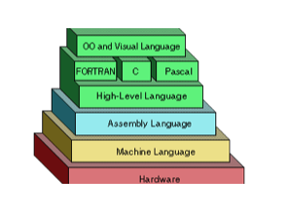
Programming Overview
The closer the language is to the hardware, the “lower level” the language is. For most of us, we will work in “higher level” languages that have compilers that translate our code into machine code or that handle our data in the same environment as the source code.
For the majority of what we will do in a masters program will be done in a higher level language, but an knowledge of the underlying theory of computer science can help us greatly improve the efficiency and power of our analysis
http://whatis.techtarget.com/definitions

Slide 5

Hardware & Programs
Personal computers
Convenient and easily accessible
Self administrator
Low levels of storage and computational power
Servers / CHPC
Easily accessible but require a higher degree of understanding
CHPC admin
Extremely high degree of storage and computational power
Programs
Program is a set of ordered operations for a computer to execute.
Programs can be built using a verity of languages.
After being compiled you have an object program, or machine level code that can communicate directly with the computers CPU
Our goal is to build programs to help us speed up analysis and reduce repetitive tasks
Programs, scripts, functions…

Slide 6

Machine Code
The lowest level of computer languages
Binary or hexadecimal instructions that a machine (hardware) can directly respond to
Highly specific tasks executed on the CPU
Almost never coded directly, but instead a higher level language is compiled (translated) into machine / binary code

Slide 7
Assembly Language
Low to intermediate level of language where expressions are composed of mnemonic (symbolic) instructions each of which correspond directly to a machine instruction.
Converted into an executable by an assembler to work directly with microprocessor
Final product of any compiler
In essence, Assembly language is like machine code but it allows the programmer to use names / symbols instead of numbers.
”For example, on the Zilog Z80 processor, the machine code 00000101, which causes the CPU to decrement the B processor register, would be represented in assembly language as DEC B.”

Slide 8
High-level Language
High-level languages can use a higher level of abstraction from a computer
natural language elements
structured programing concepts (if-else-than)
concepts of syntax
“uses English and mathematical symbols in its instructions”
Low-level languages are hardware specific.
Compiler:
A compiler is a special program used to convert from higher level code to lower level
The output is called object code (program)

Slide 9
Make (tab) & Executable Files
Make Files:
A special format file that guides UNIX make utility to select which program files are to be compiled and linked together.
If you are only modifying a single file than a make file isn’t necessary, but if you are modifying a single file in a program comprised of thousands of files, a make file will identify which portions have been changed
Executable Files (.exe)
A compressed File that performs functions or operations on a computer. Can not be read since it has been compressed to a low –level language.
In reality any file congaing instructions for a computer could be called an executable, even in a scripting language source code

Slide 10
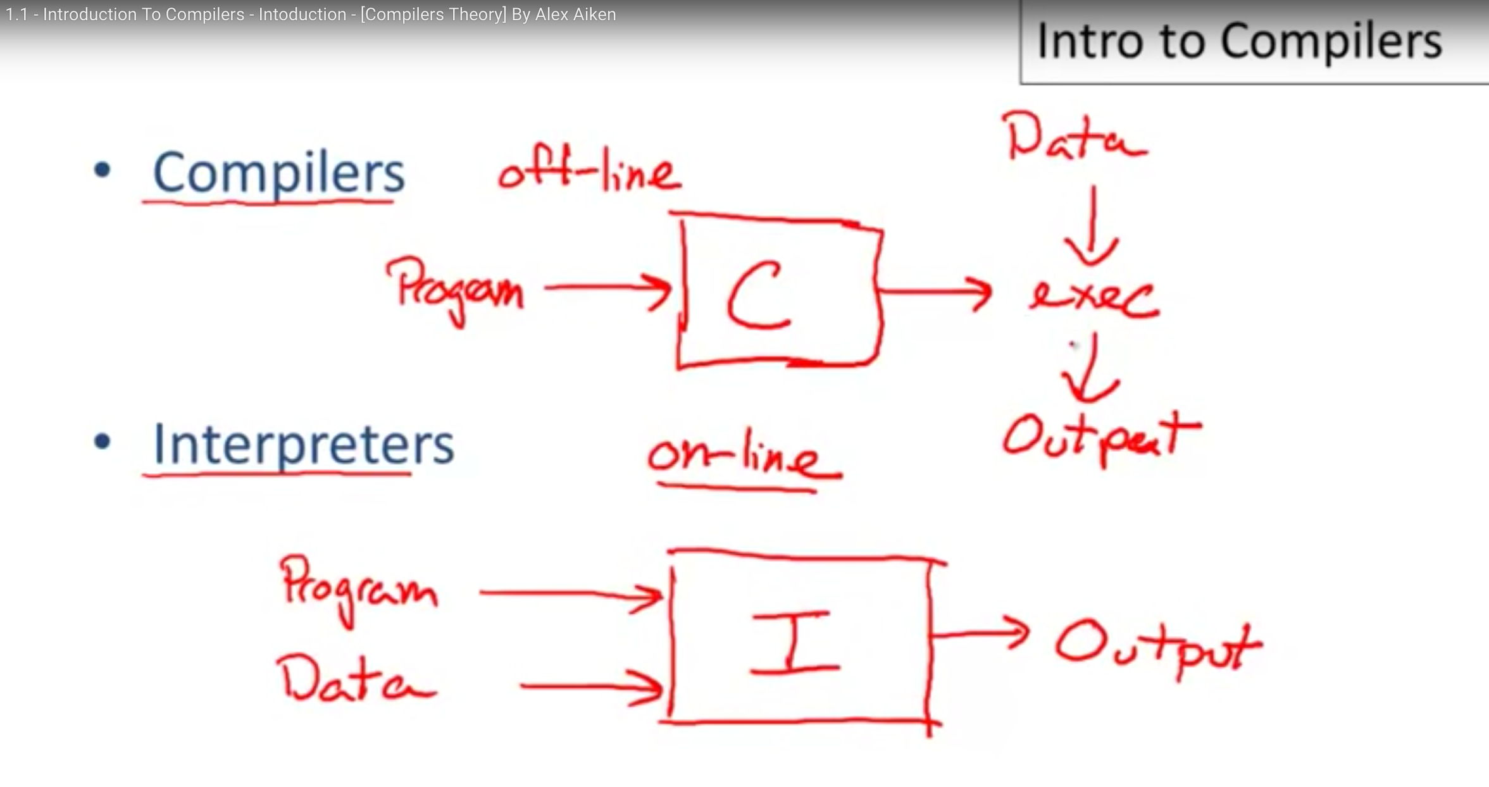
Interpreter
A computer program or environment that directly executes scripts on data with out compiling them into machine code.
Programs that handle your data and scripting language code on-line
Hardware has gotten to be very powerful in recent
years. As a result we can use interpreters for
substantially more powerful operations and on
much larger data sets than in the past. Many
higher-level languages allow you to use interpreters
exclusively, and the ease of programming in these
environments can outweigh the increased run-time
gained when using a compiled program
Ex: 2hr vs 2 days of coding = 30 min run time diff.
http://whatis.techtarget.com/definitions

Slide 11
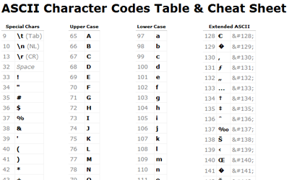
GUI editor
A visual user interface for developing and running source code.
Allows the user to interact with graphical icons beyond text-based user interfaces.
R vs Rstudio
Text File
Any file that contains data formatted as text
Commonly used to store information
ASCII character set is the most common from of encoding

Slide 12
Syntax
Language specific structure of higher level abstraction and order of operations
Grammar, structure or order of elements in a given language
= vs. ==, “” vs. ‘’, () vs. [], if-else-if,
“Logic is Logic, syntax is whatever” – Chris Galli

Slide 13
Class Question
Given your new found knowledge regarding Higher and Lower-level languages, where do you envision you will spend most of your time during your graduate career?
Data analysis vs. computer programming?

Slide 14

Overview of languages used in ATMOS
Lets discuss some of the languages common to Atmos Science.
Given the language diversity of this class some of us will have lots of experience in these languages, some wont…
Unix
Fortran
Idl
Scripts
Python
Matlab
R

Slide 15
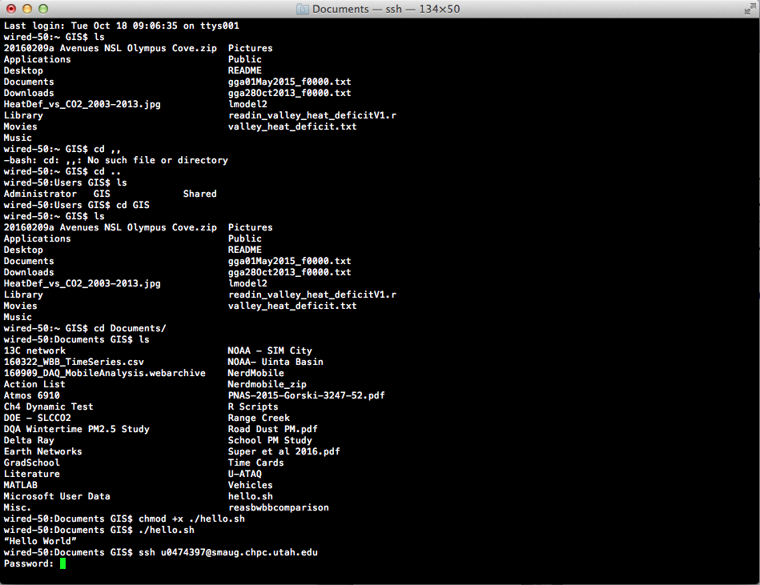
Unix
Operating System written in predominantly C
Open source, so available on a wide array of systems
Some key concepts:
SSH
SFTP
SCP

Slide 16
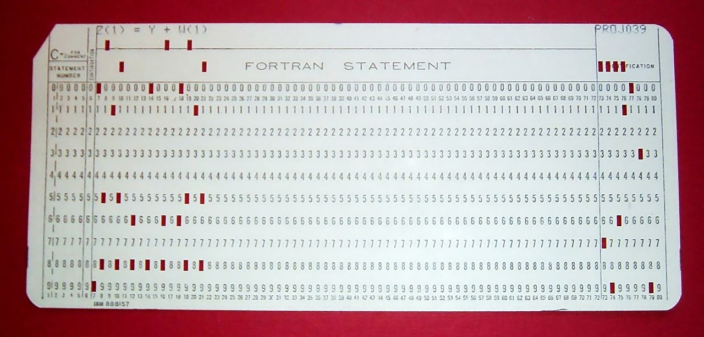
Fortran
Originally developed as a compiler to Translate Formulas (1950’s)
Suited to numeric computations and scientific computing
Numerical weather perdition
Fluid dynamics
Physics and Chemistry

Slide 17
Interactive Data Language (Idl)
Primarily used for data analysis and visualizations
Works well with large amounts of data including data processing.
Satellite data…
Limited online community

Slide 18
Script
A program that is executed by another program rather than by the computer processor.
Special run-time environments that automate the execution of tasks. Cron tab scripts.
Lets re-do our Homework 1 section 2 as a script!
What are some useful scripts we can run to help our day to day?

Slide 19
Python
Emphasizes code “readability” and minimizing lines of code.
Object oriented language.
Works on many OS working on a lot of systems.
Packaged as stand alone executable.
Great environment for communicating with additional hardware / the outside world

Slide 20


Matlab & R
Integrated suits of software for data manipulation, simulation, visualization and statistical analysis.
Command line or GUI interactions.
The open source nature of R and its free licensing has allowed it to greatly expand in applications.
Text and spatial data.
.csv files

Slide 21
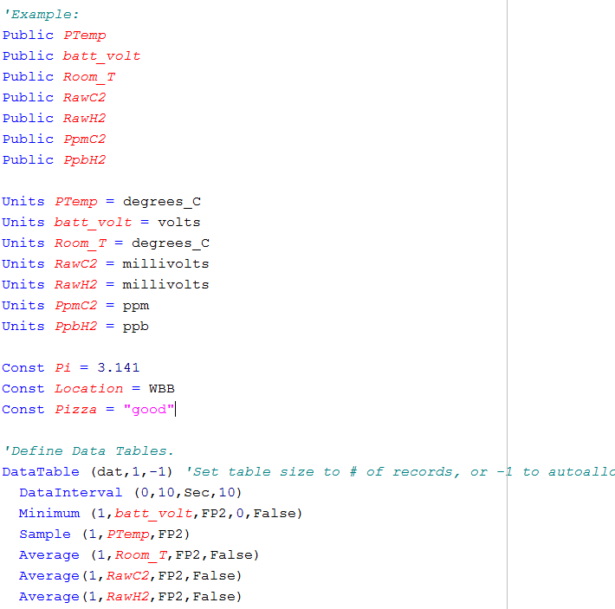
Data Types
Variable: Storage location paired with a symbolic identifier
Use something that is descriptive but concise
“CO2” “Atmospheric_Carbon_Dioxide”…. “Time” “Time_Of_Measurent”
Include Units! “CO2_ppm” “Time_UTC”
Best example… “CO2ppm_cal”
If need be, headers were invented for a reason… Outline each variable if confusion is likely.
Easy to rename variable early on, it gets harder after scripts have been built.
Constant: It is constant! The program can not alter this variable during execution.
Pi
If you define a constant make sure you never want to use that variable in any other instance

Slide 22
Data Type
Undefined: Not previously defined by the program. In most higher-level programming languages variables are defined by the environment. Pay attention to how they are assigned
Integer: A whole number. c(1:1000)
Numeric: Fractional numbers. 1.000, 10.8, 400.559, Pi
Float: Similar to a numeric, but stored in memory differently.
String: An array of bites. Usually used for words.
Boolean: True / False
POSIX(ct or lt): Time specific format as either seconds since January 1, 1970 or as a vector where each entry has a specific meaning tied to the various components of time (HH, MM, SS)

Slide 23
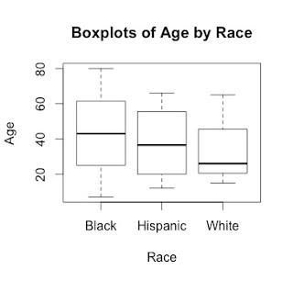
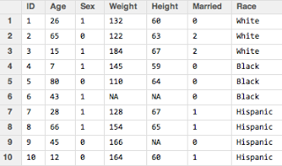
Data Types
Factors: variables where integer values are mapped to a character string.
Factors are useful for summary statistics. A factor will have the number of levels, in the above example that would be 3

Slide 24
Class Examples

Slide 25
Reading and Homework
Using a terminal or SPFT client, download the assignment from the class website.
Please send me the work sheet and the CSV file created.

