Slide 1
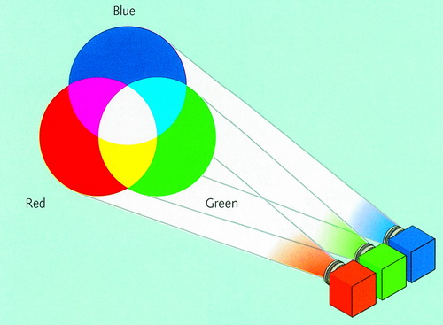
Images and Colortables
Notes:
Problem may not be with data but how it is displayed.
A color is composed of 3 specific values
Color triple

Slide 2
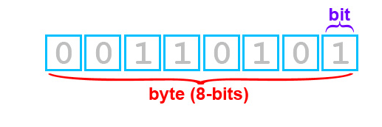
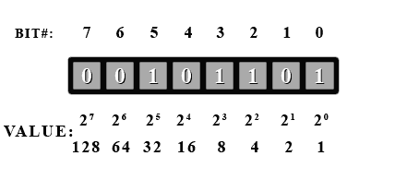
A little binary
00000000 = 0
00000001 = 1
00000010 = 2
00000011 = 3
00000100 = 4
00000101 = 5
11111111 = 255

Slide 3
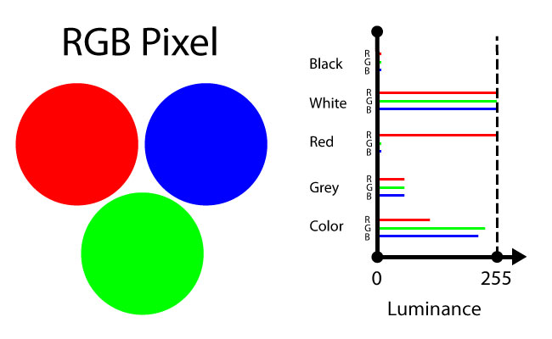
RGB

Slide 4
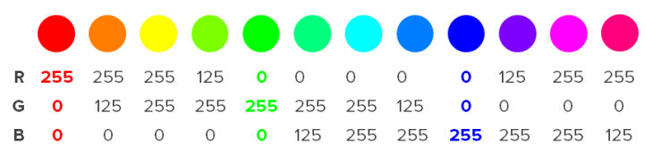
Some RGB triplets

Slide 5
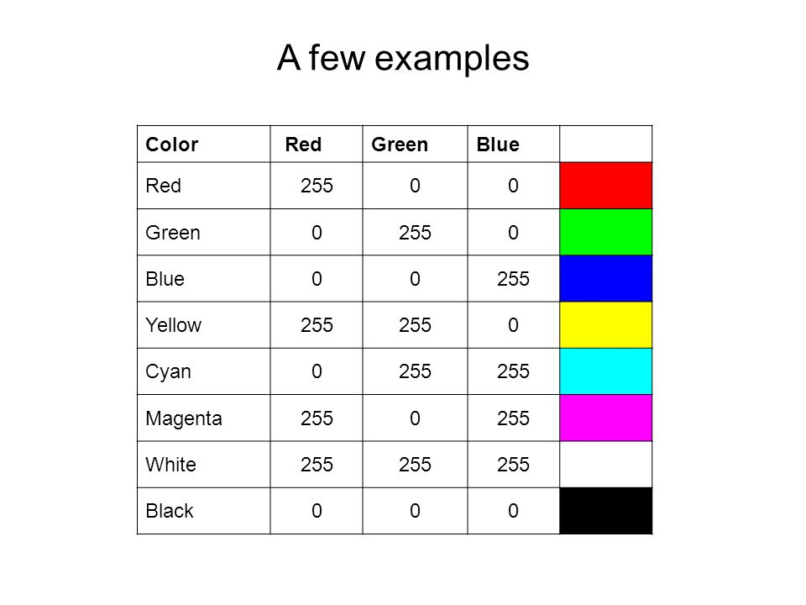
Simple colortable
1
2
3
4
5
6
7
8

Slide 6
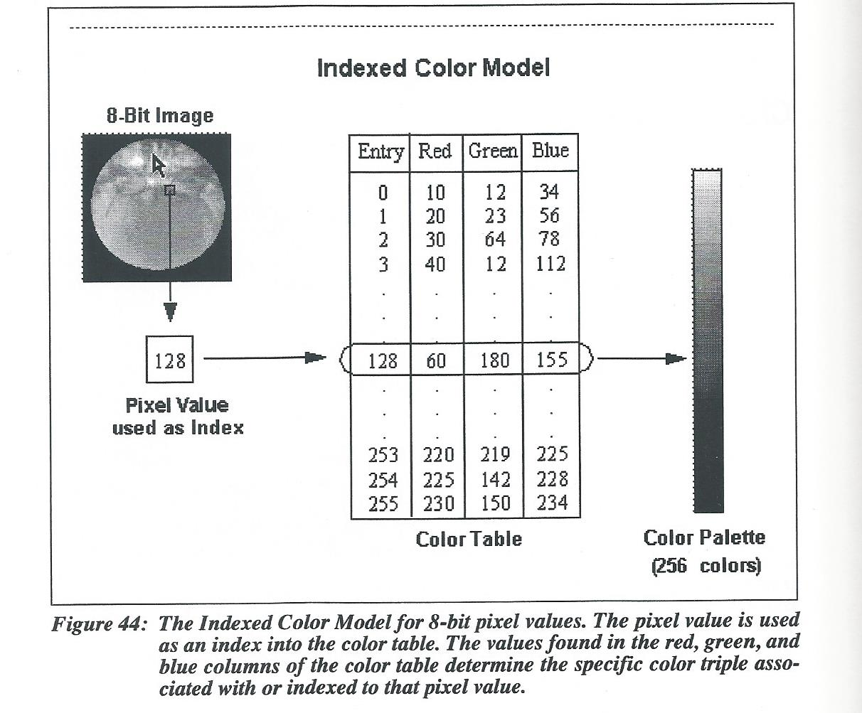
8 bit (1 byte) pixel values

Slide 7
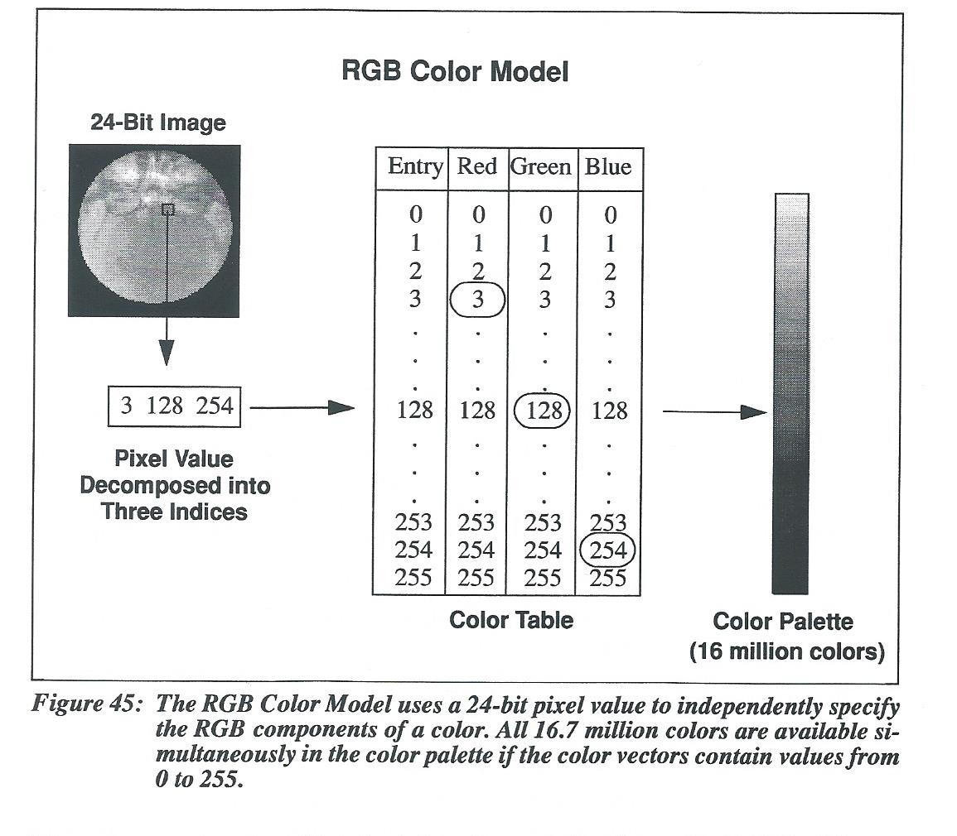
24 bit (3 byte) pixel values

Slide 8
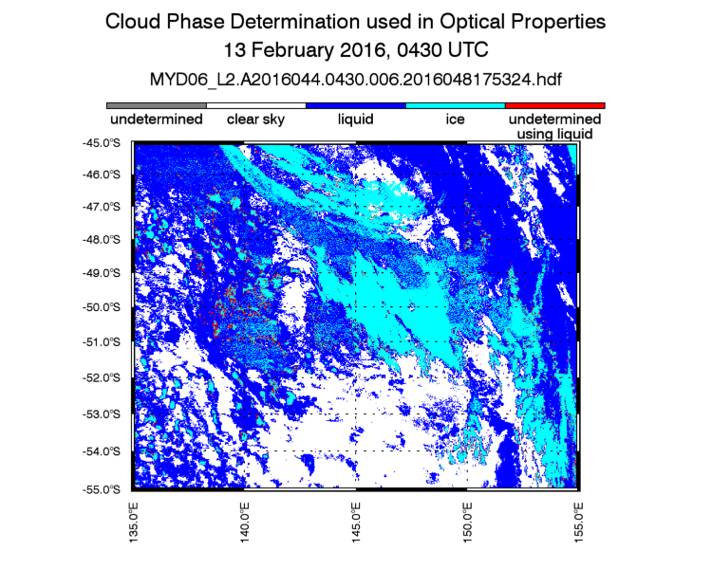
Any 2d data set can be though of as an image.

Slide 9
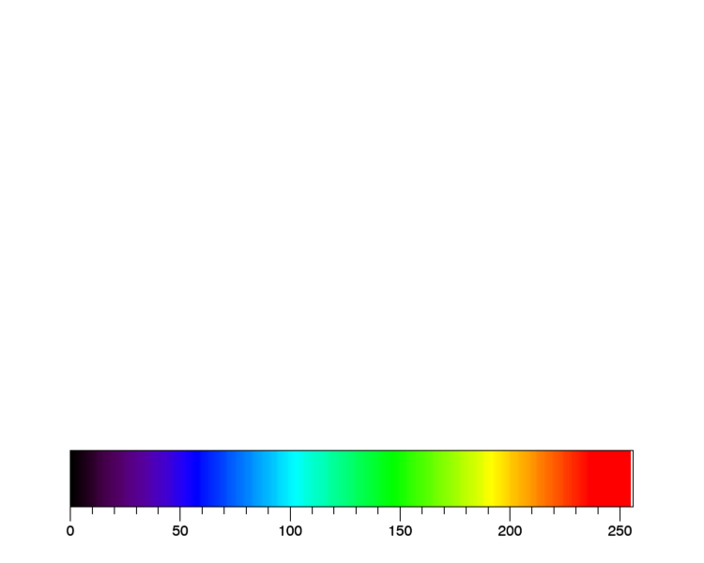
Byte Scaling
Data min
Data max
-40
25

Slide 10
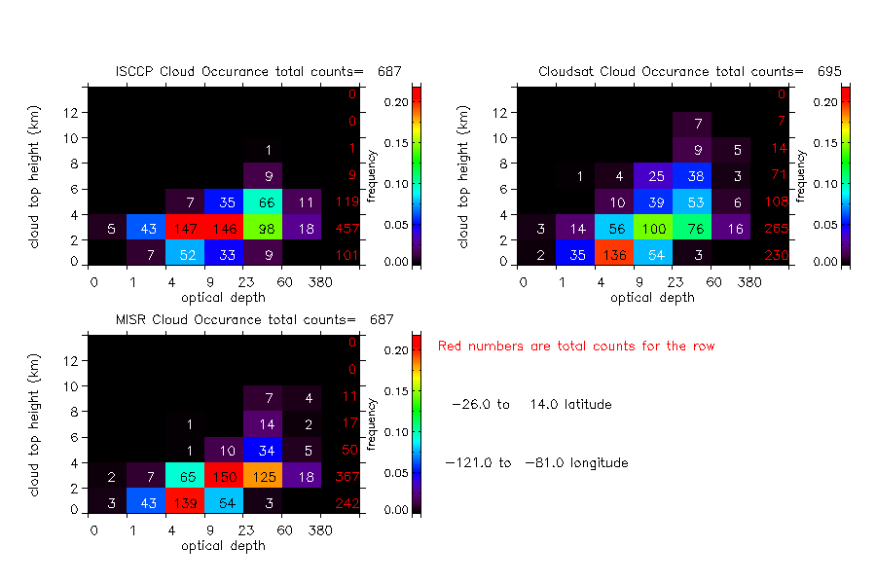

Slide 11
Resizing the byte array

Slide 12
Image File Formats
Standardized means of organizing and storing digital images.
RASTER IMAGES – grid of pixels
Describes the characteristics of each individual pixel
TIFF (.tif) tagged image file format
Very large, uncompressed, detailed, used in photoshop
JPEG (.jpg) Joint Photographic Experts Group
small, compressed, digital cameras, pictures on web.
GIF (.gif) Graphic Interchange Format
limited colors (256), compressed
PNG (.png) Portable Network Graphics
replaces gif, supports 24-bit true color (16 million colors)

Slide 13
Image File Formats
VECTOR IMAGES
Contain a geometric description which can be rendered smoothly at any desired display size
Vector graphics are rasterized in order to be displayed on digital monitors
Best for printing
PostScript (.ps)
computer language, scaleable
Encapsulated PostScript (.eps)
self-contained postscript that can be placed within another postscript document
PDF largely based on postscript

Slide 14
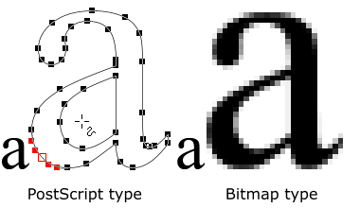
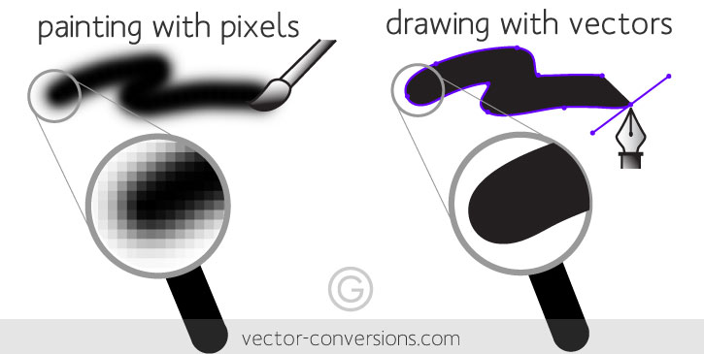
Vector vs Raster

Slide 15
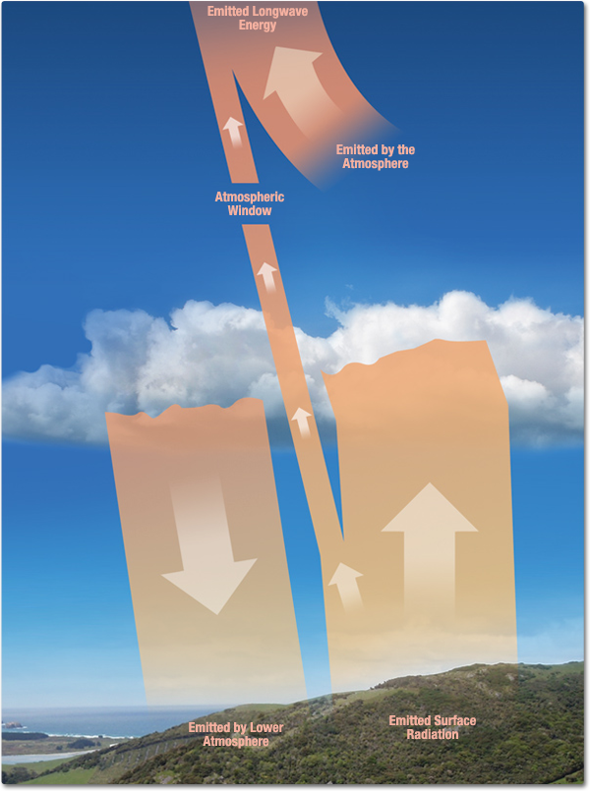
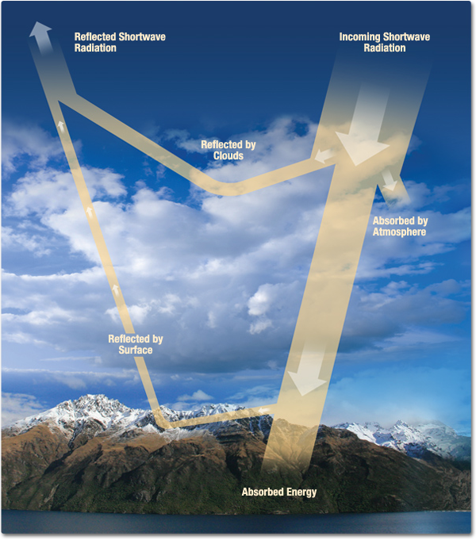
Earth’s Radiation Budget

Slide 16
ISCCP: International Satellite Cloud Climatology Project
Established in 1982
Collects weather satellite radiance measurements to analyze and infer the global distribution of clouds, their properties, and their diurnal, seasonal and interannual variations.
Cloud top temperature/pressure
The satellite measures the infrared radiation emitted by the cloudy scene, which is assumed to be covered completely by clouds at one level. If the cloud is optically thick, it radiates like a blackbody so that the observed emission is equivalent to the actual temperature at the top
Cloud optical thickness
This parameter represents the optical thickness of clouds at visible wavelengths (approximately 0.6 microns). It is determined from the satellite-measured visible solar reflectivity of cloudy scenes, assuming that the pixel is uniformly covered by clouds. The retrieval depends on an assumed particle size and shape.

Slide 17
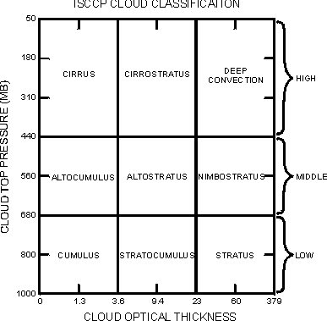
ISCCP Cloud Classification
Cloud Types
A value of cloud top pressure and optical thickness is obtained for each cloudy pixel during the daytime. This information can be used to classify different cloud types as shown in the figure.

Slide 18
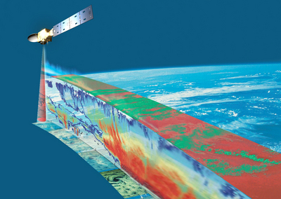
CloudSat

Slide 19
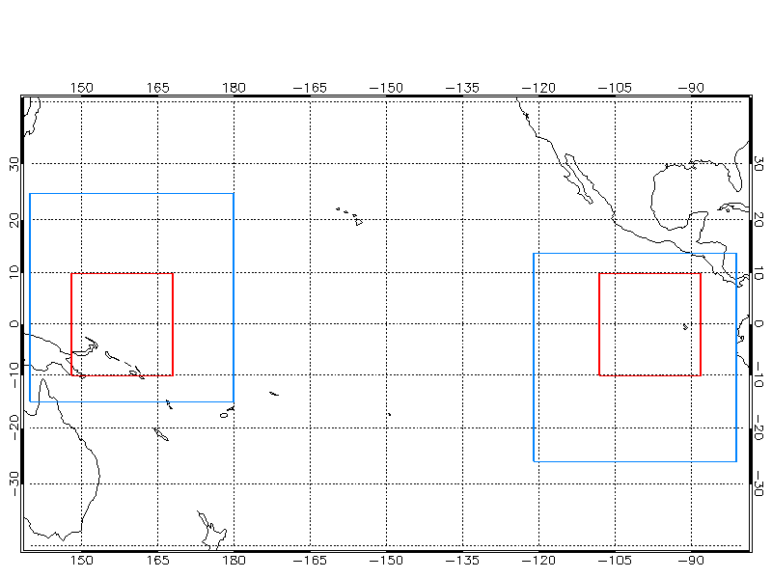
Pacific Region

Slide 20
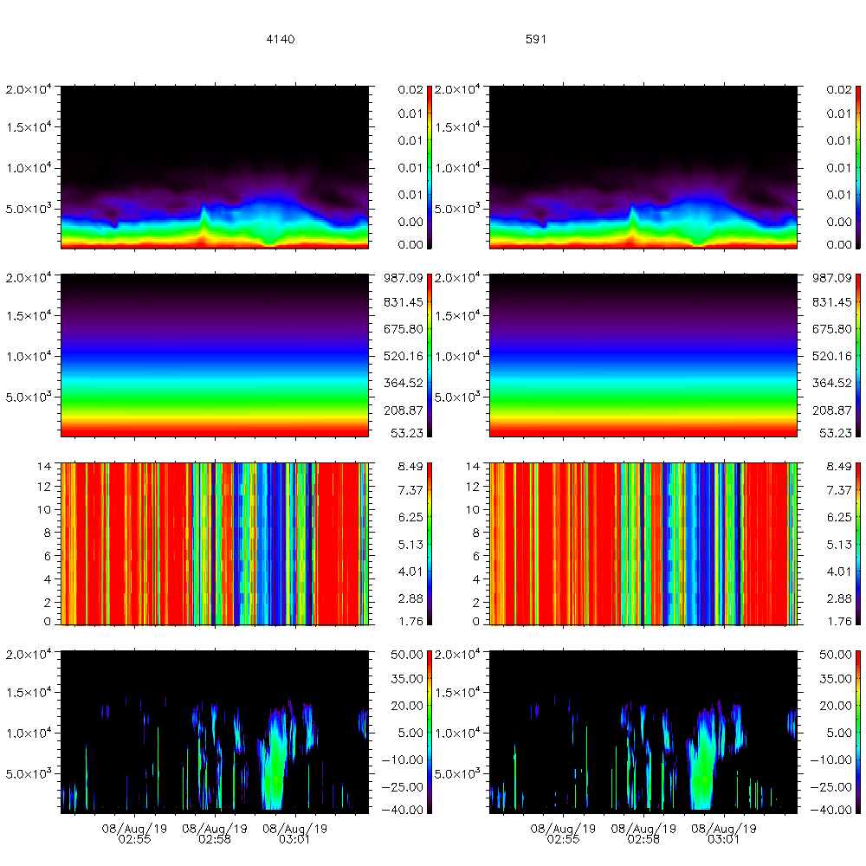
Averaging Data
19 Aug 2008
Use images to check your work
Data input - first place for error
Data averaging – second place for error
0.16 second interval (1.1km along track distance)
The midpoint time of the averaging time interval is used to represent the time of the interval mean
Mean of a set of Means?
Depends on the sample number.
RAW
Averaged
Specific humidity
Pressure
ch 31 rad
DBZ

Slide 21
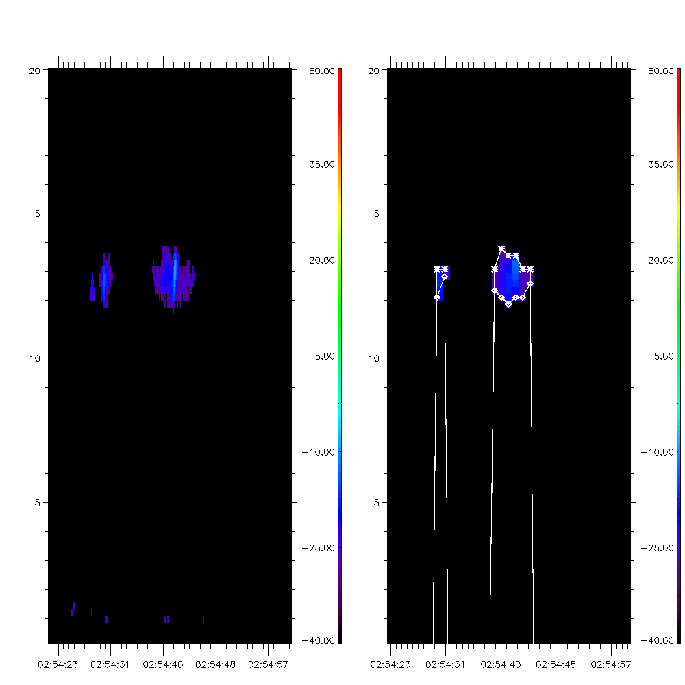
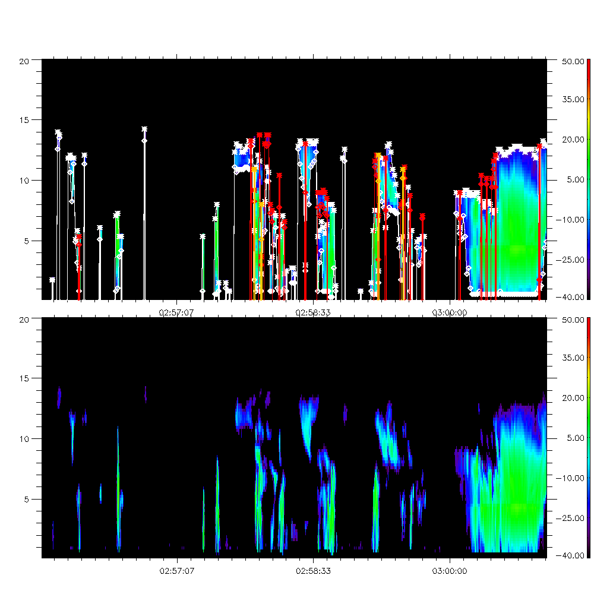
Finding cloud top and base
Original data had cloud layer information. Should I average those values to get an average layer top?

Slide 22
Now that we have the cloud top pressure of each cloudsat profile. How does that compare to the ISCCP cloud top pressure and optical depth value of the profile?
netcdf isccp_profiles_east_200806 {
dimensions:
profiles = UNLIMITED ; // (16802 currently)
variables: double cloudsat_profile(profiles) ;
double julian_day(profiles) ;
float cs_lat(profiles) ;
float cs_lon(profiles) ;
float actual_top(profiles) ;
float actual_base(profiles) ;
float actual_ptop1(profiles) ;
float isccp_cloud_top_height(profiles) ; float isccp_ptop(profiles) ;
float total_tau(profiles) ;
float zenith_angle(profiles) ;
float top_layer_top(profiles) ;
float top_layer_base(profiles) ;
float top_layer_thickness(profiles) ;
float actual_top2(profiles) ;
float actual_base2(profiles) ;
float actual_ptop2(profiles) ;
float s_layer_top(profiles) ;
float s_layer_base(profiles) ;
float s_layer_thickness(profiles) ;
float actual_top3(profiles) ;
float actual_base3(profiles) ;
float actual_ptop3(profiles) ;
float t_layer_top(profiles) ;
float t_layer_base(profiles) ;
float t_layer_thickness(profiles) ;}

Slide 23
Frequency Distribution
30
180
310
440
560
680
800
1000
data_counts=num_tau_bins X num_ctp_bins
For i=0,num_ctp_bins do begin
For j=0,num_tau_bins do begin
result=where(ctp le pbin[i] and
ctp gt pbin[i+1] and
tau ge tbin[i] and
tau lt tbin[i+1],count)
data_counts[i,j]=count
endfor
Endfor
data_freq=data_counts/total(data_counts)
Cloud top pressure (mb)
0 1 4 9 23 60 380
Optical depth

Slide 24
ISCCP cloud top pressure vs tau
30
180
310
440
560
680
800
1000
760 | 339 | 24 | 15 | 20 | 191
166 | 478 | 234 | 292 | 465 | 419
141 | 289 | 148 | 293 | 456 | 148
45 | 213 | 122 | 355 | 367 | 39
8 | 323 | 609 | 3035 | 917 | 72
2 | 102 | 682 | 2795 | 841 | 64
2 | 13 | 170 | 480 | 226 | 11
ISCCP Cloud top pressure (mb)
0 1 4 9 23 60 380
Optical depth

Slide 25
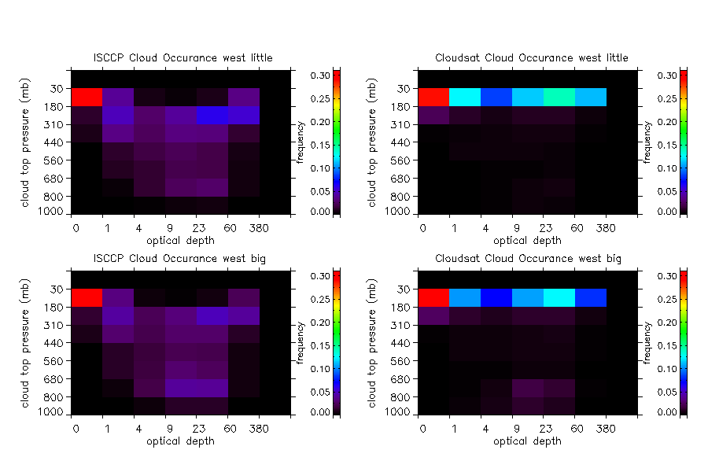

Slide 26
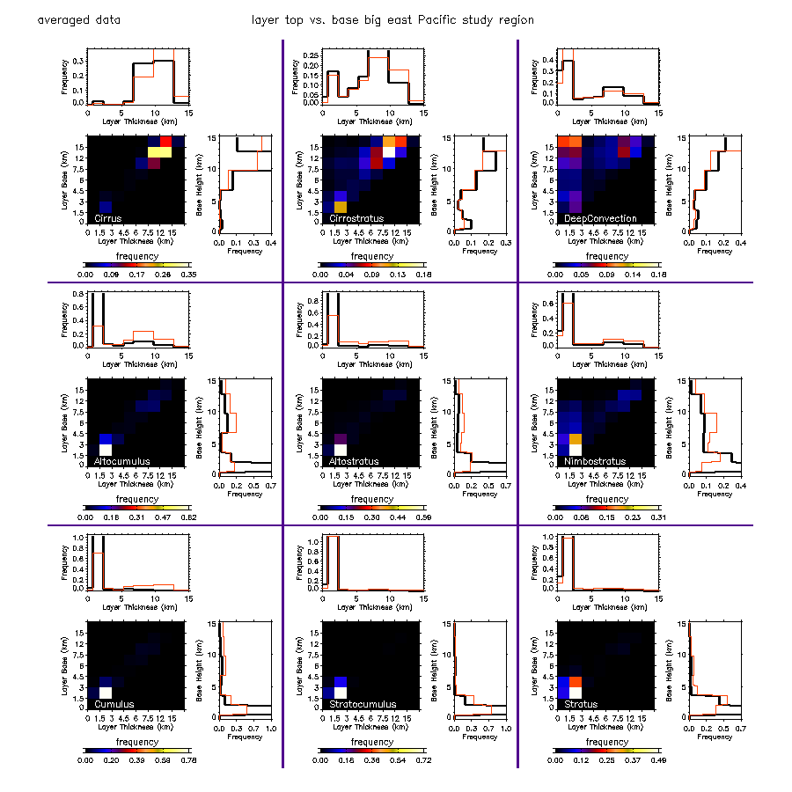

Slide 27
Optimizing
Separate programs for averaging, finding cloud tops, and then plotting to save time
Homework
Isccp cloud top pressure vs. cloudsat cloud top pressure

Slide 29
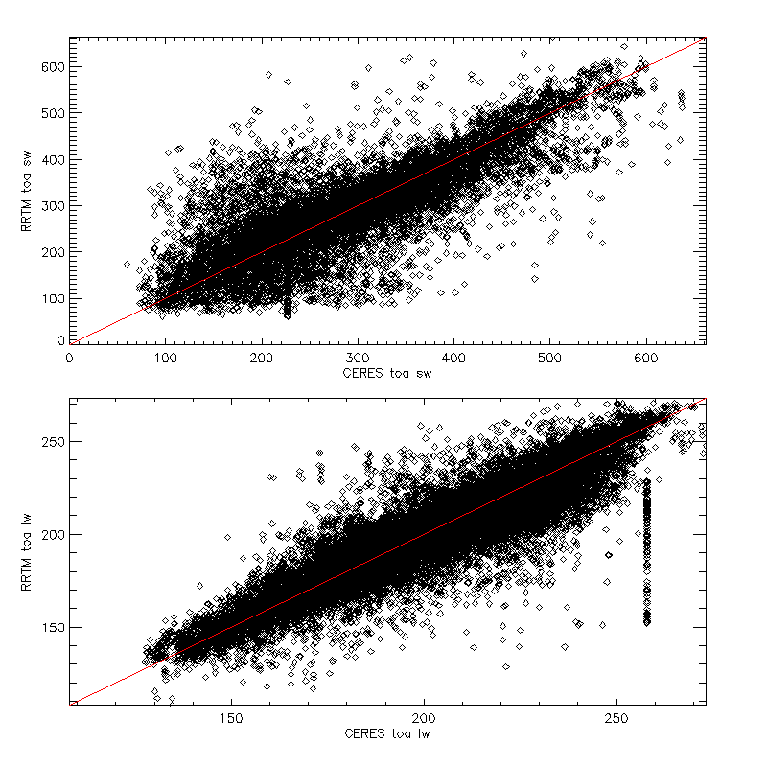
How do we find these points?
Ceres toa lw
c_flux gt 250 and c_flux lt 260
RRTM toa lw
abs(c_flux-r_flux) gt 30
idx=where(c_flux gt 250 and c_flux lt 260 and
abs(c_flux-r_flux) gt 30,count)
c_flux_bad=c_flux[idx]
r_flux_bad=r_flux[idx]
julian_day_bad=julian_day[idx]
caldat,julian_day_bad,mm,dd,yy,hh,mi,ss

Slide 30
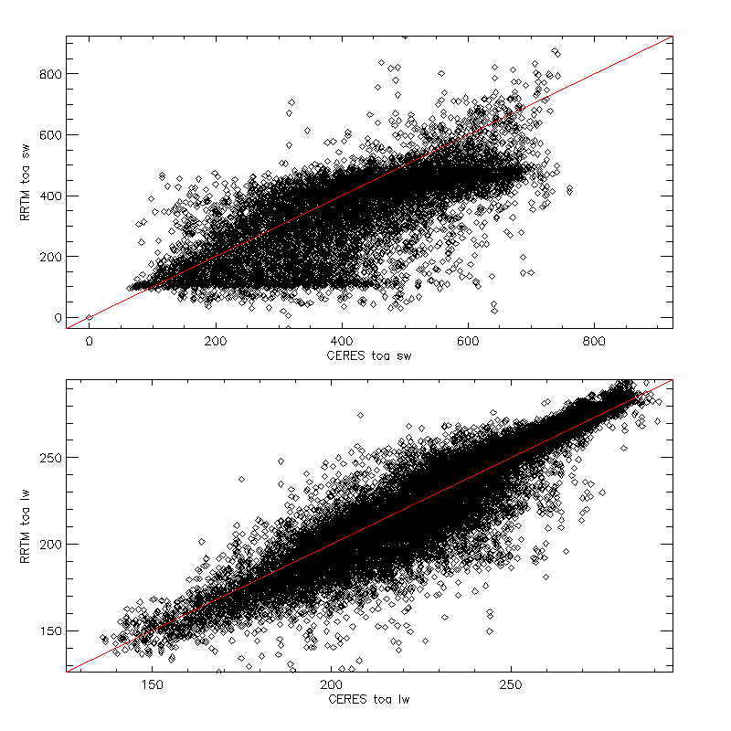
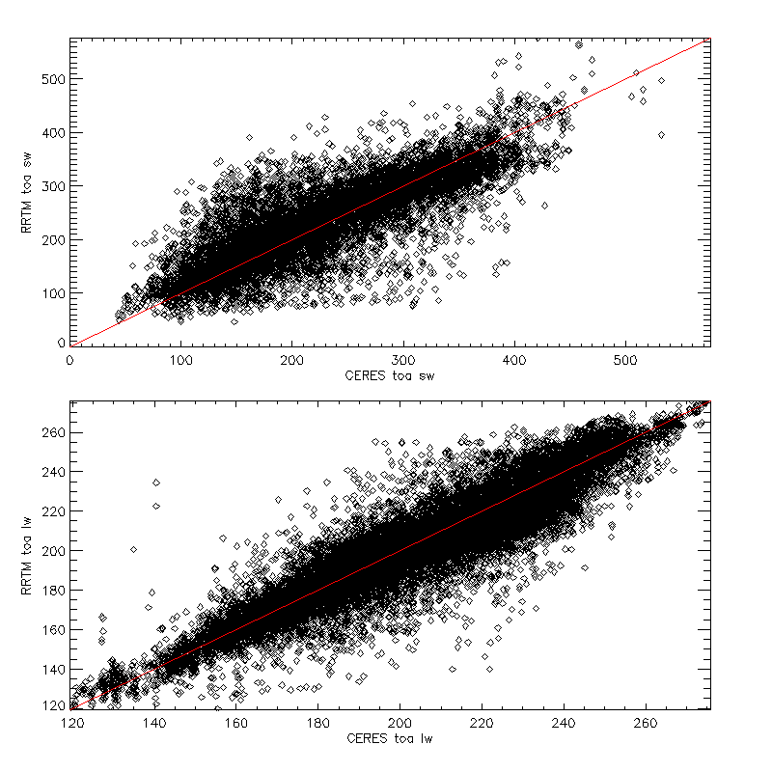
July 2008
January 2008

Slide 31
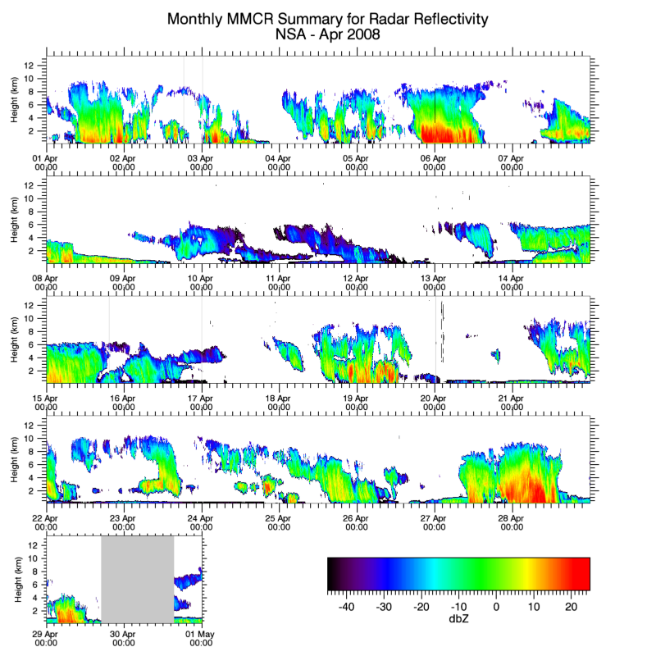
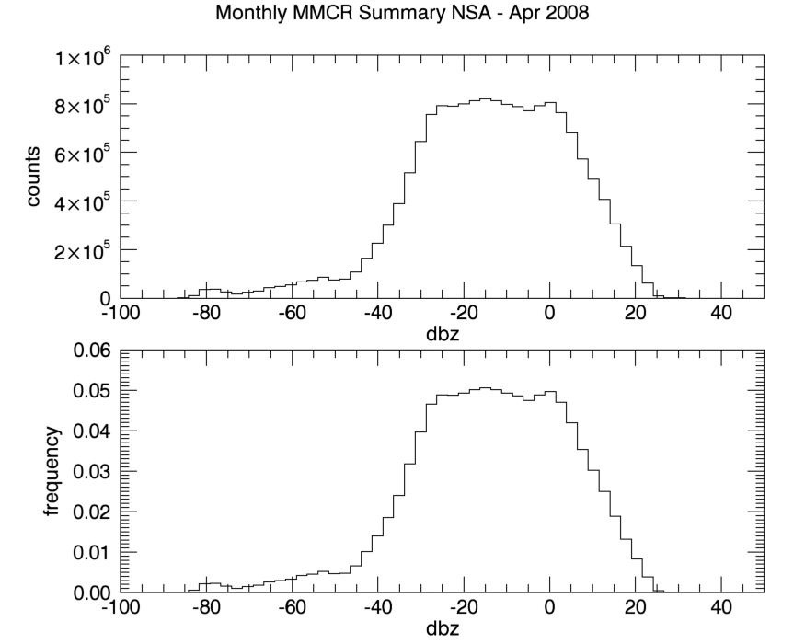
How do we start looking for issues with our calculated values?
-94.3000 -91.7812 -89.2624 -86.7436 -84.2248 -81.7060 -79.1872 -76.6684 -74.1496 -71.6308 -69.1120 -66.5932 -64.0744 -61.5556 -59.0368 -56.5180 -53.9992 -51.4804 -48.9616 -46.4428 -43.9240 -41.4052 -38.8864 -36.3676 -33.8488 -31.3300 -28.8112 -26.2924 -23.7736 -21.2548 -18.7360 -16.2172 -13.6984 -11.1796 -8.66083 -6.14203 -3.62323 -1.10443 1.41437 3.93317 6.45197 8.97077 11.4896 14.0084 16.5272 19.0460 21.5648 24.0836 26.6024 29.1212 31.6400 34.1588
PDF (probability density function)
Bar chart that shows how many data points are within a range (an interval) called a bin
even bins, uneven bins, counts, frequency
start_bin=dmin
end_bin=dmax
dbin=(end_bin-start_bin)/100

Slide 32
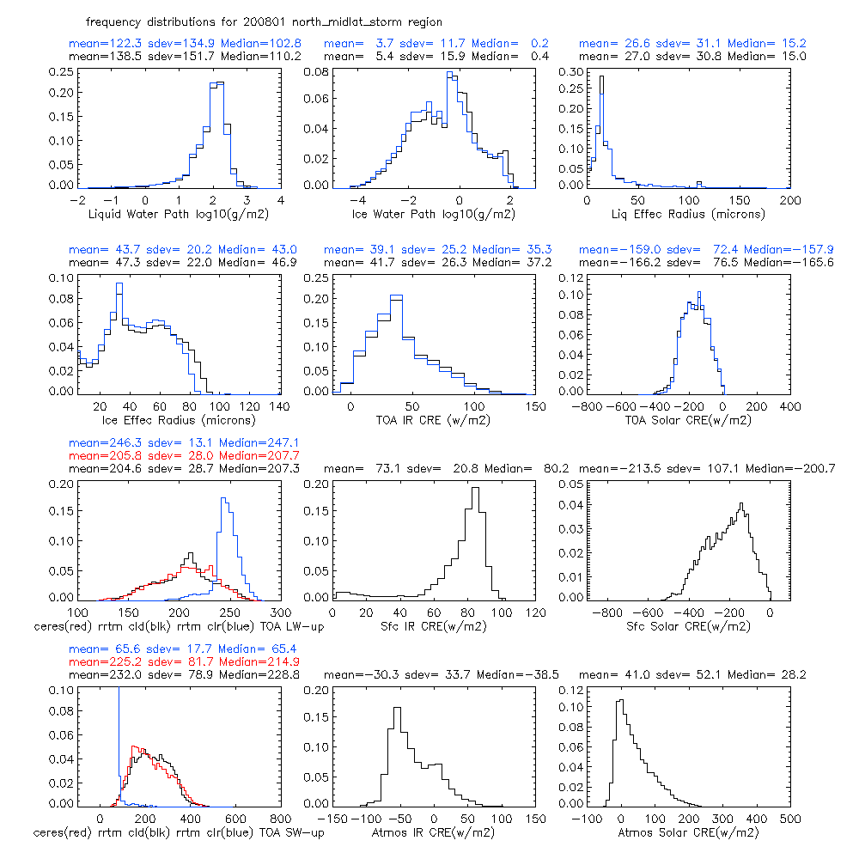
Black=all profiles
Blue=exclude profiles with a max dbz ge 10

Slide 33
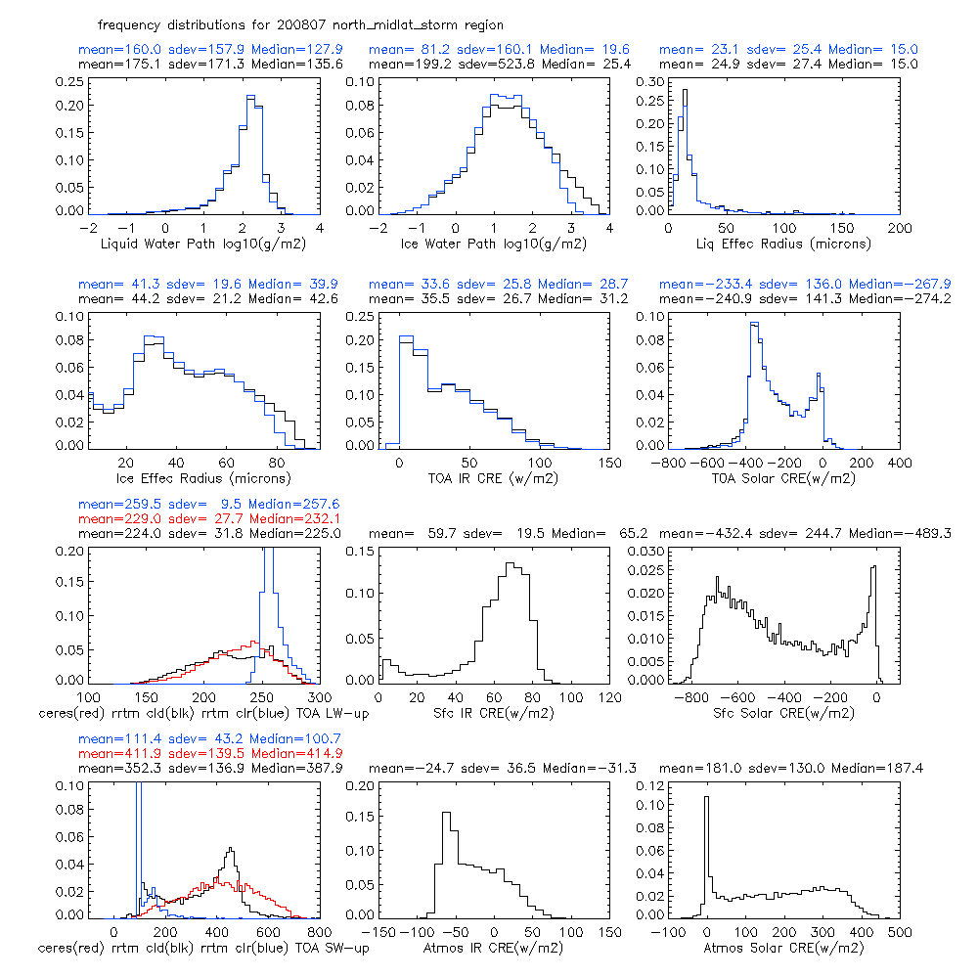

Slide 34
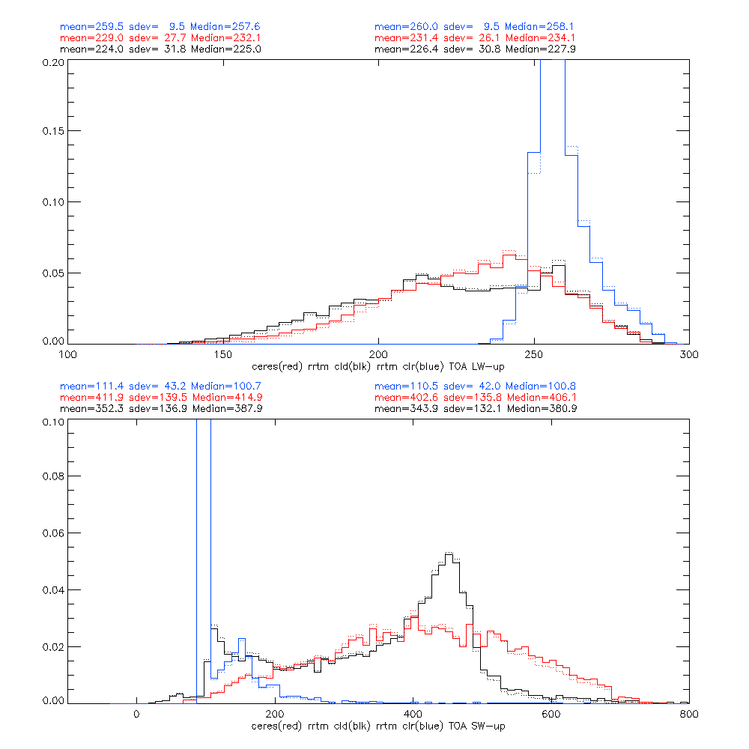
Idx=where(c_flux gt 600 and r_flux gt 400 and r_flux lt 500
Dotted line=profiles with max dbz of 10 excluded.

Slide 35
WHERE (WHICH, FIND)
cloud_base=[4,7,9,2,10,9,10] units=kilometers
0 1 2 3 4 5 6
result=where(cloud_base GE 8.0,count)
count=4
result=[2,4,5,6]
cloud_base_high=cloud_base[result]
cloud_base_high=[9,10,9,10]

