Slide 1
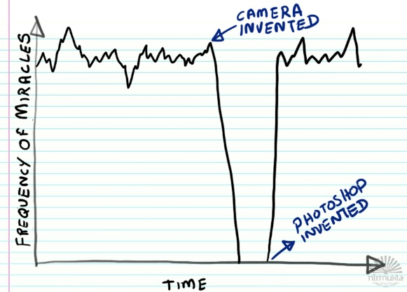
Scientific Figures
https://imgur.com/gallery/akeVeiq

Slide 2
What makes a good scientific figure?
Edward Tufte describes the visual display of information in terms of "Graphical Excellence".
The well‐designed presentation of interesting data, containing substance, statistics and design
Complex ideas are distilled down with clarity, precision and efficiency
Delivers the reader the greatest number of ideas in the shortest time with the least ink in the smallest space
Almost always multivariate
Requires telling the truth about the data
Tufte, Edward R. The Visual Display of Quantitative Information; Graphics Press: Cheshire, CT, 1983;
pp 1‐197. Graphical Excellence
Notes:
Clearly this slide breaks some of these design rules. So lets distill this down even further
"The most important contribution so far to the study of the graph.” JOURNAL OF THE AMERICAN STATISTICAL ASSOCIATION

Slide 3
What makes a good scientific figure?
Clarity, no ambiguity as what is being represented
Efficiency, reduced noise and junk
Truthful results, don't be a politician
Notes:
That last slide was similar to many figures we see, so lets make it simpler

Slide 4
What we will talk about
Captions
Readability
Fonts
Axes
Layout
Export

Slide 5
Captions
Describe all the axes
Include information about the experiment to ensure understanding
Discuss the curves/markers in the figure
Match the markers used in the figure in the caption

Slide 6
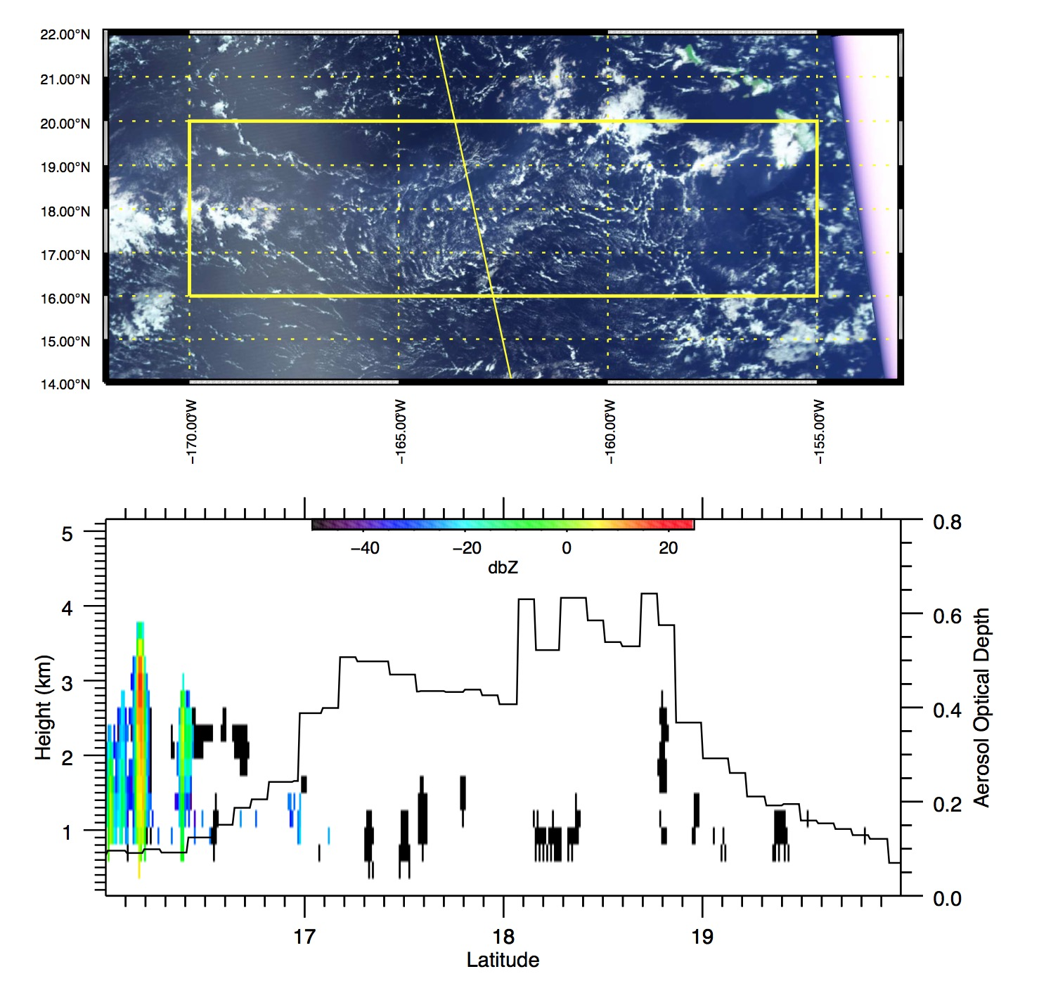
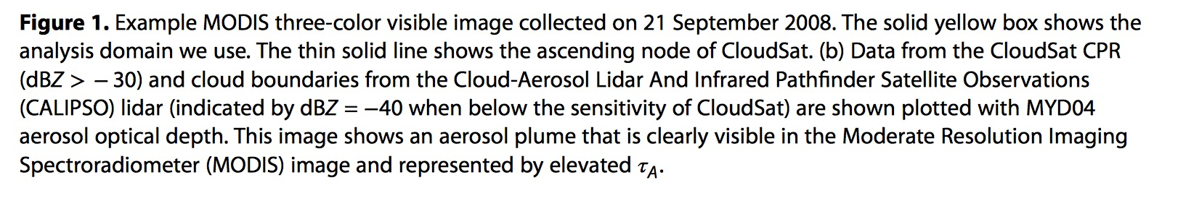
Mace, G. G., and A. C. Abernathy (2016), Observational evidence for aerosol invigoration in shallow cumulus downstream of Mount Kilauea, Geophys. Res. Lett., 43, 2981–2988, doi:10.1002/2016GL067830.

Slide 7
Readability
The figure is concise and clear
Uses legible fonts
Productive use of colors; no use colors that don't reproduce well
Accessible; people who are color blind or visually impaired
High resolution image; don't scale up a bitmapped image

Slide 8
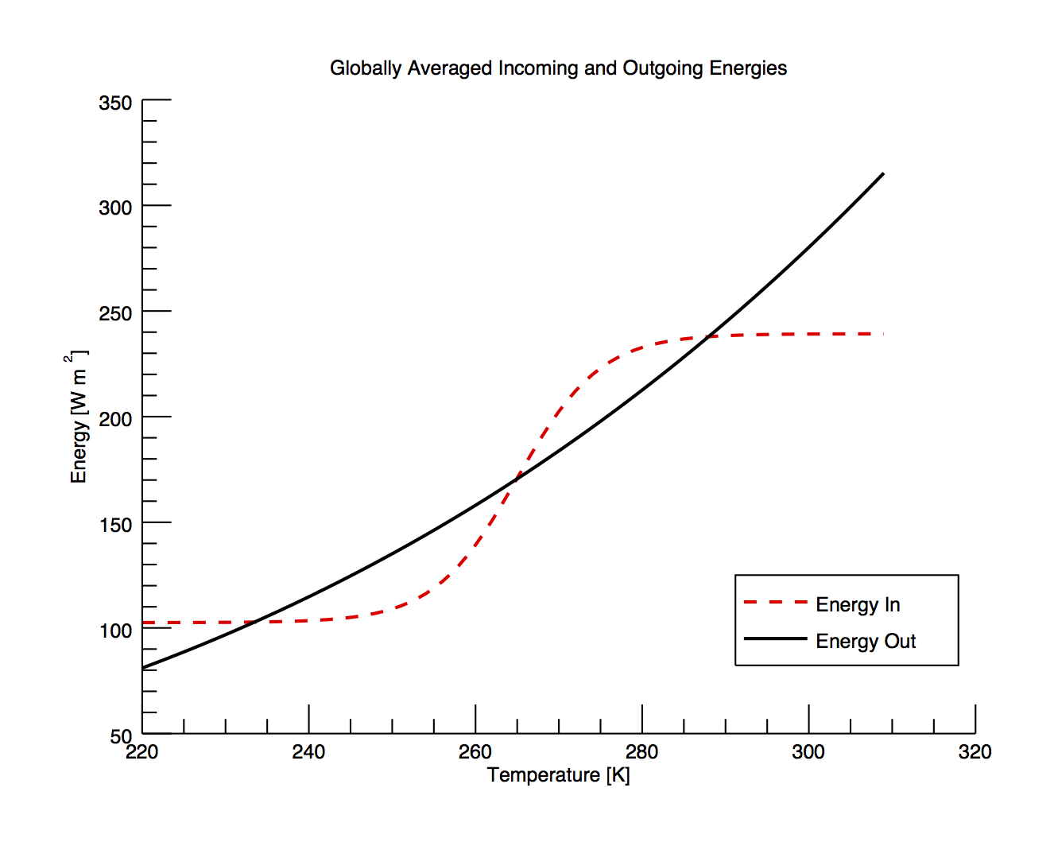
Notes:
Simple figure shows the incoming and outgoing energies in a simple line plot.

Slide 9
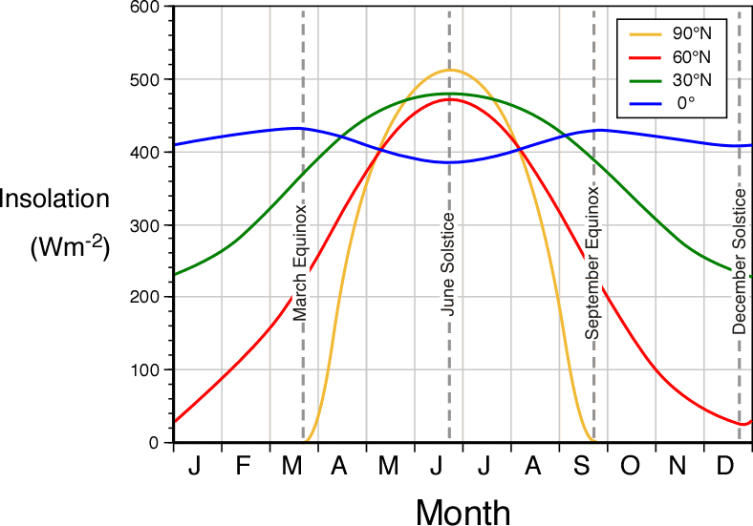
http://www.physicalgeography.net/fundamentals/6i.html
Notes:
Onward to colors…
What’s wrong with this?

Slide 10
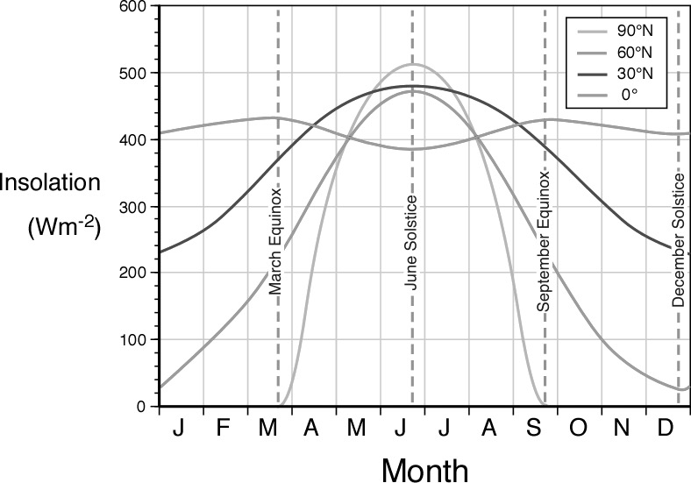
Notes:
So if you print this on a BW printer, what do you have now?
What if you are color blind?

Slide 11
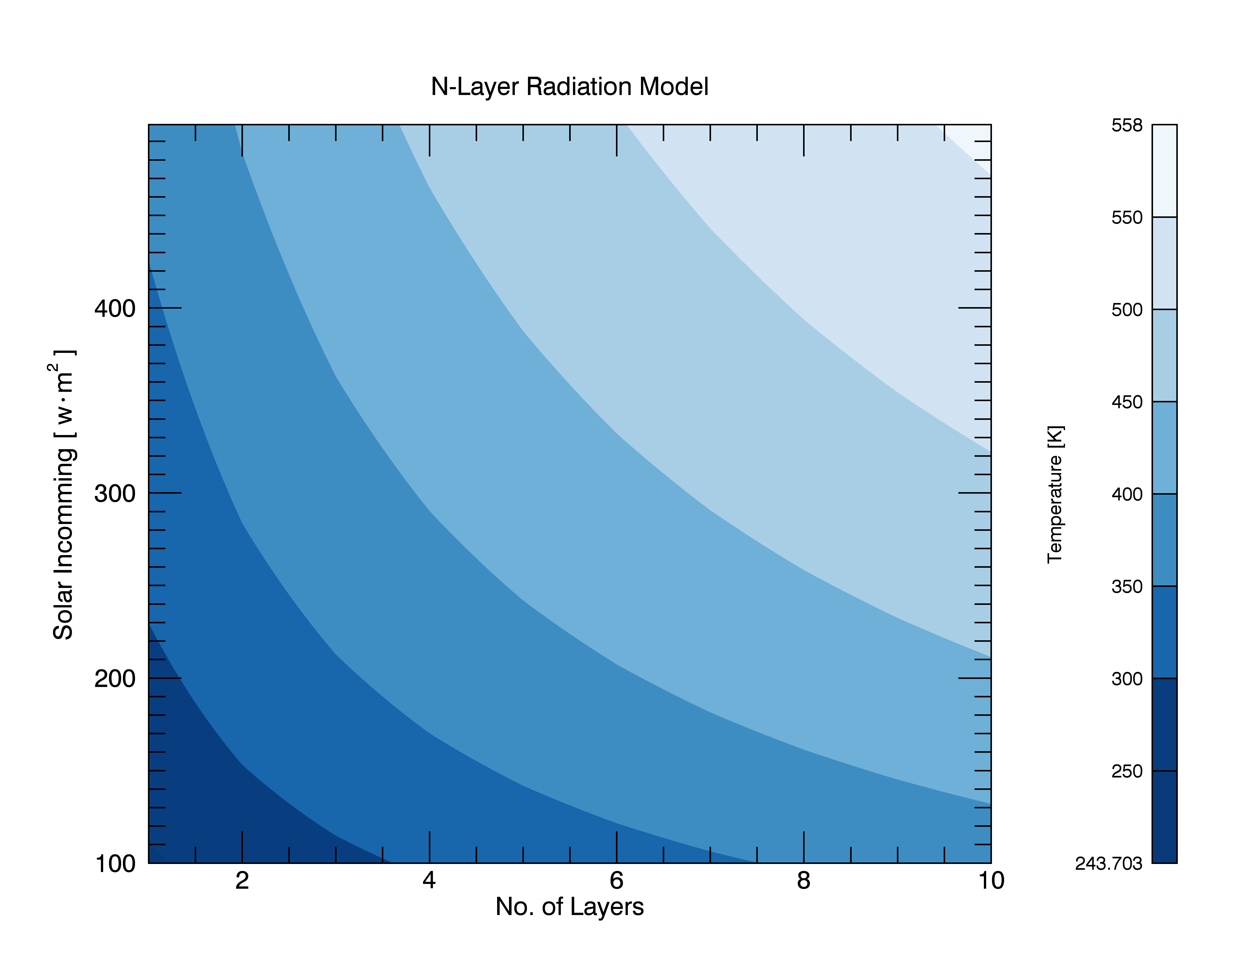

Slide 12
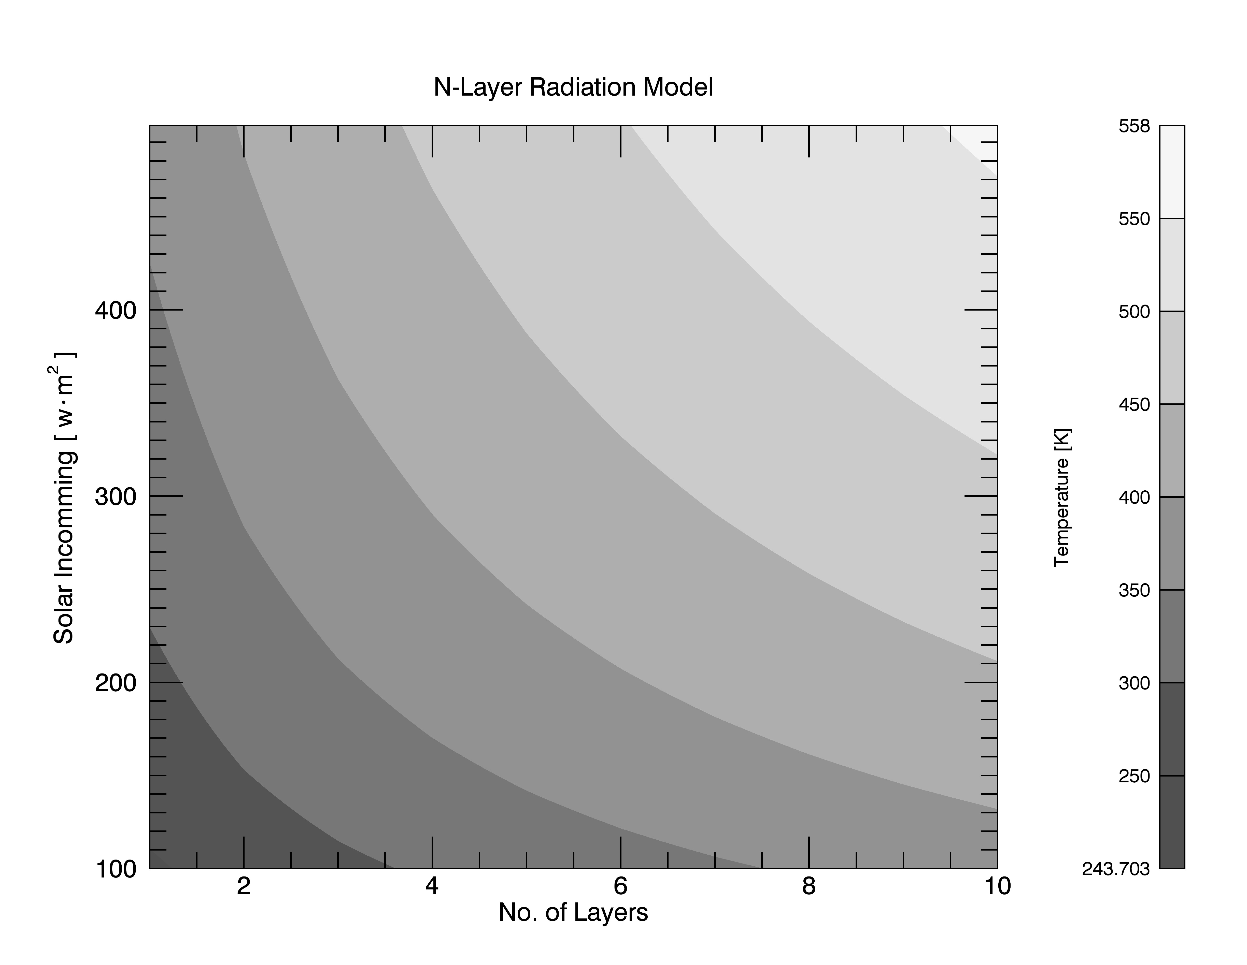
Notes:
If you are going to use color, try using the same color, just in a gradient.

Slide 13
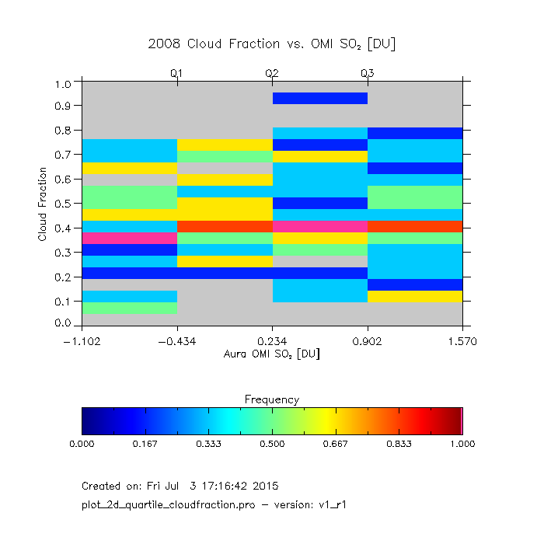
Notes:
What about this one?
Keep in mind this is a diagnostic figure; what is really bad about this?

Slide 14
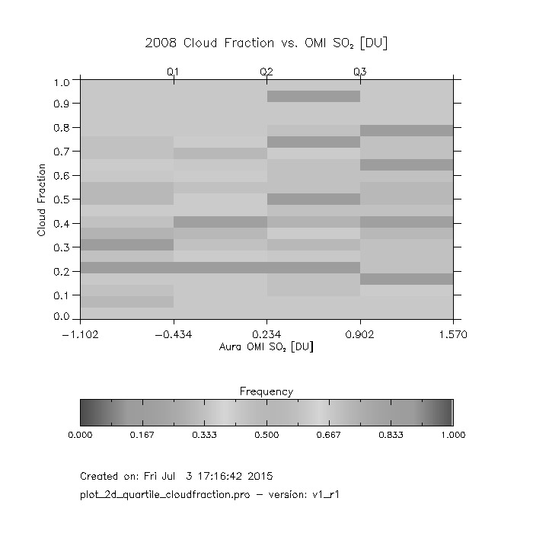
Notes:
We have no data.

Slide 15
Using fill colors
Notes:
Wanted to know the min and max of KE as time progresses

Slide 16
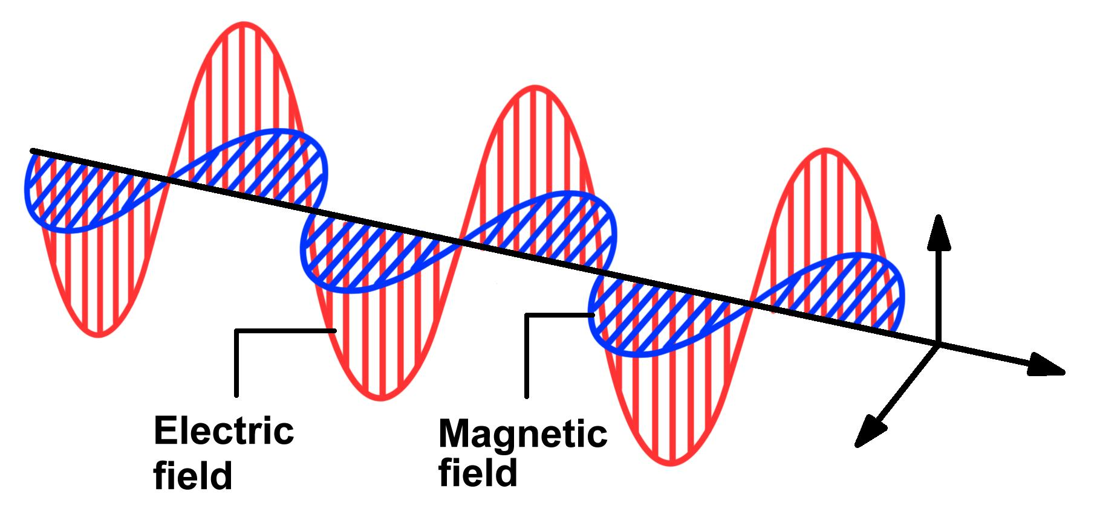
http://ffden-2.phys.uaf.edu/webproj/212_spring_2014/Amanda_Mcpherson/Amanda_McPherson/
em_electric_magnetic_propagating_waves.jpg
Notes:
We’ve all seen this before. This is a good example to show us the direction of things.
or an magic eye game

Slide 17
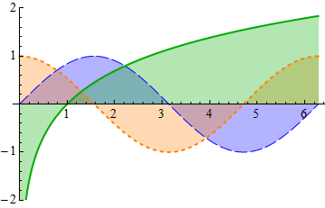
Are the colors helpful or a hindrance?
https://i.stack.imgur.com/qjamj.png

Slide 18
On fonts…
Use bolding selectively
Use large font size
Use both upper and lower case letters
Use sans-serif font
Notes:
Font styling here differs from Tufte’s view points, Tufte is a designer and an amazing one at that, but per many journals that relate to our field, they prefer sans-serif fonts.
AGU, Science, AMS prefer Arial or Helvetica

Slide 19
Serif vs. San-Serif
Fixed-width or “Typewriter” font, used to display things such as computer code.
Easier to read in printed mediums. Used to control the “flow” of the eye.
Better at smaller print sizes, and survive reproduction. Use these for your figures
Notes:
A little bit about fonts
Georgia, fixed, Helvetica
Fixed 79 chars, 12 words
Serif 74 chars, 14 words
Sans-serif, 83, 13

Slide 20
Labels
Label the all axes
Use indicator labels sparingly
Be consistent with all figures
Use common conventions with variables and axes

Slide 21
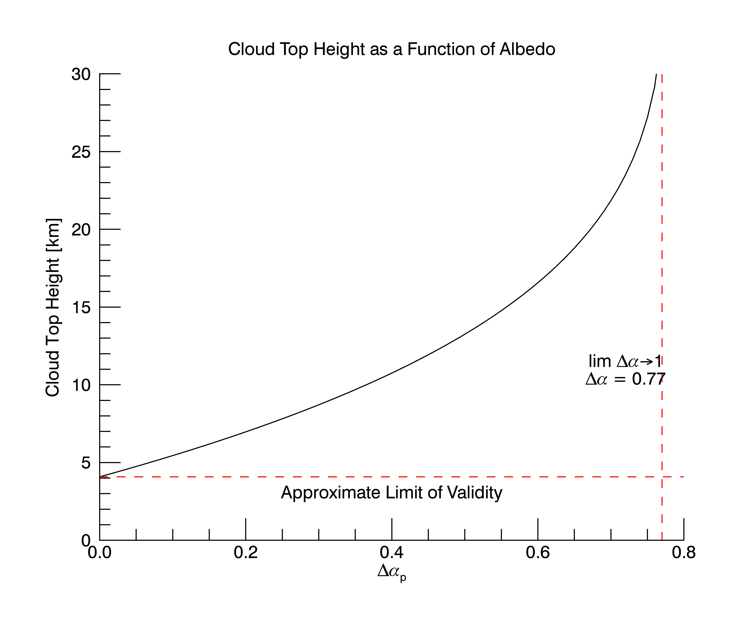
Not the clearest label ever
Notes:
What could be misunderstood about this plot?
The limit discussed here is a computational limit, in reality the solution turns complex and IDL can’t resolve it without further code.

Slide 22
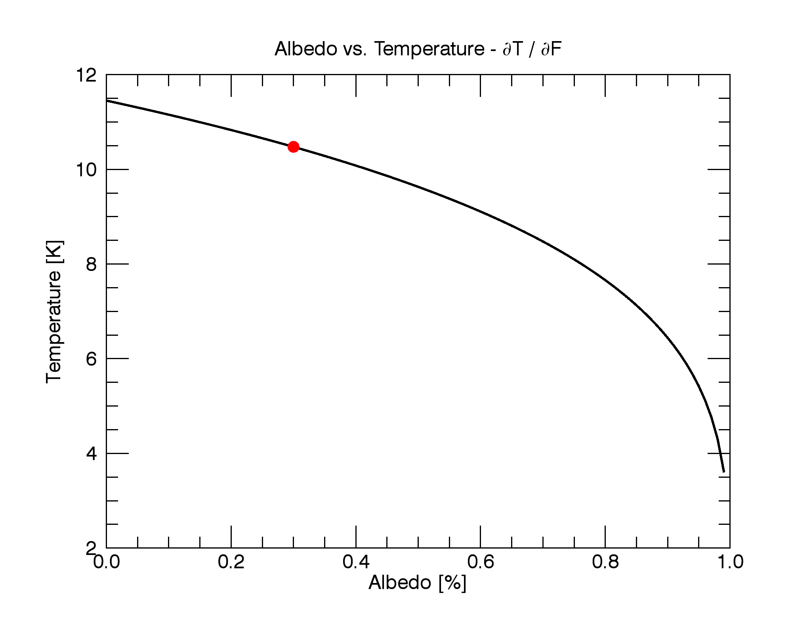
Simple dot goes a long way. As long as you note it in the caption
Notes:
Simple dot goes a long way. As long as you note it in the caption

Slide 23
Axes (not axis)
Use appropriate scale
Labeled
Readable
Stacked (multiple plots), should be aligned if applicable

Slide 24
Notes:
Let’s revisit this one.
This one has all the good parts.

Slide 25
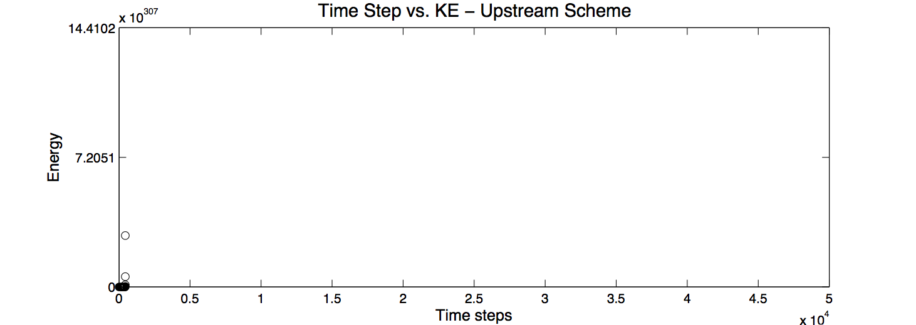
This plot tells us nothing
Notes:
I can’t read this!

Slide 26
Layout
Graphics should tend toward the horizontal, greater in length than height

Slide 27
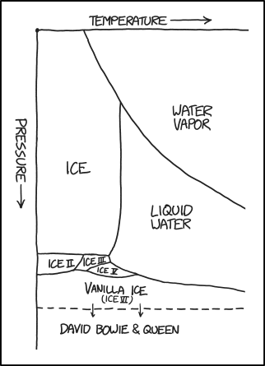
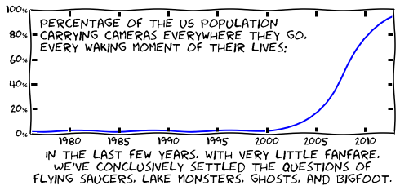
Takes up far more real estate, compared to this one
http://jakevdp.github.io/blog/2013/07/10/XKCD-plots-in-matplotlib/
http://xkcd.com/1561/

Slide 28
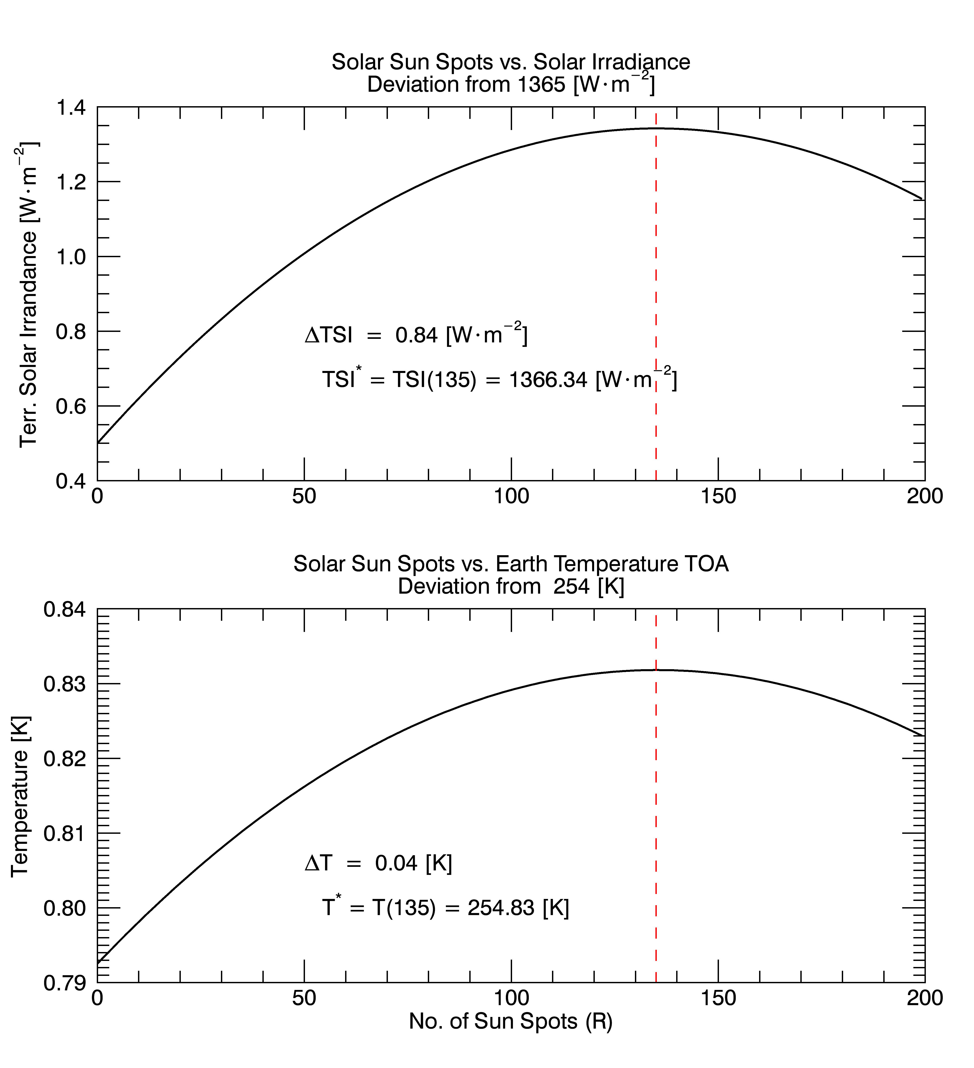
Notes:
"Linked" axes

Slide 30
A better idea… Why?
Notes:
- The eye can follow the satellite's path of travel without having to play the orientation game in your head

Slide 31
Notes:
One could argue either way on this one.
A) The quartiles are significantly chosen
B) The quartiles are all close enough they should have been all the same

Slide 32
Export formats
Nearly all journals want your images in EPS (Encapsulated PostScript)
This format is a vector based image, meaning it can scale without resolution loss.
Python, IDL, MatLab, R and most others can export to EPS.
Note the oddities in some programs (missing symbols etc.)
Notes:
Raster bad (dot matrix layout), vector good (bunch of math eqns).

Slide 33
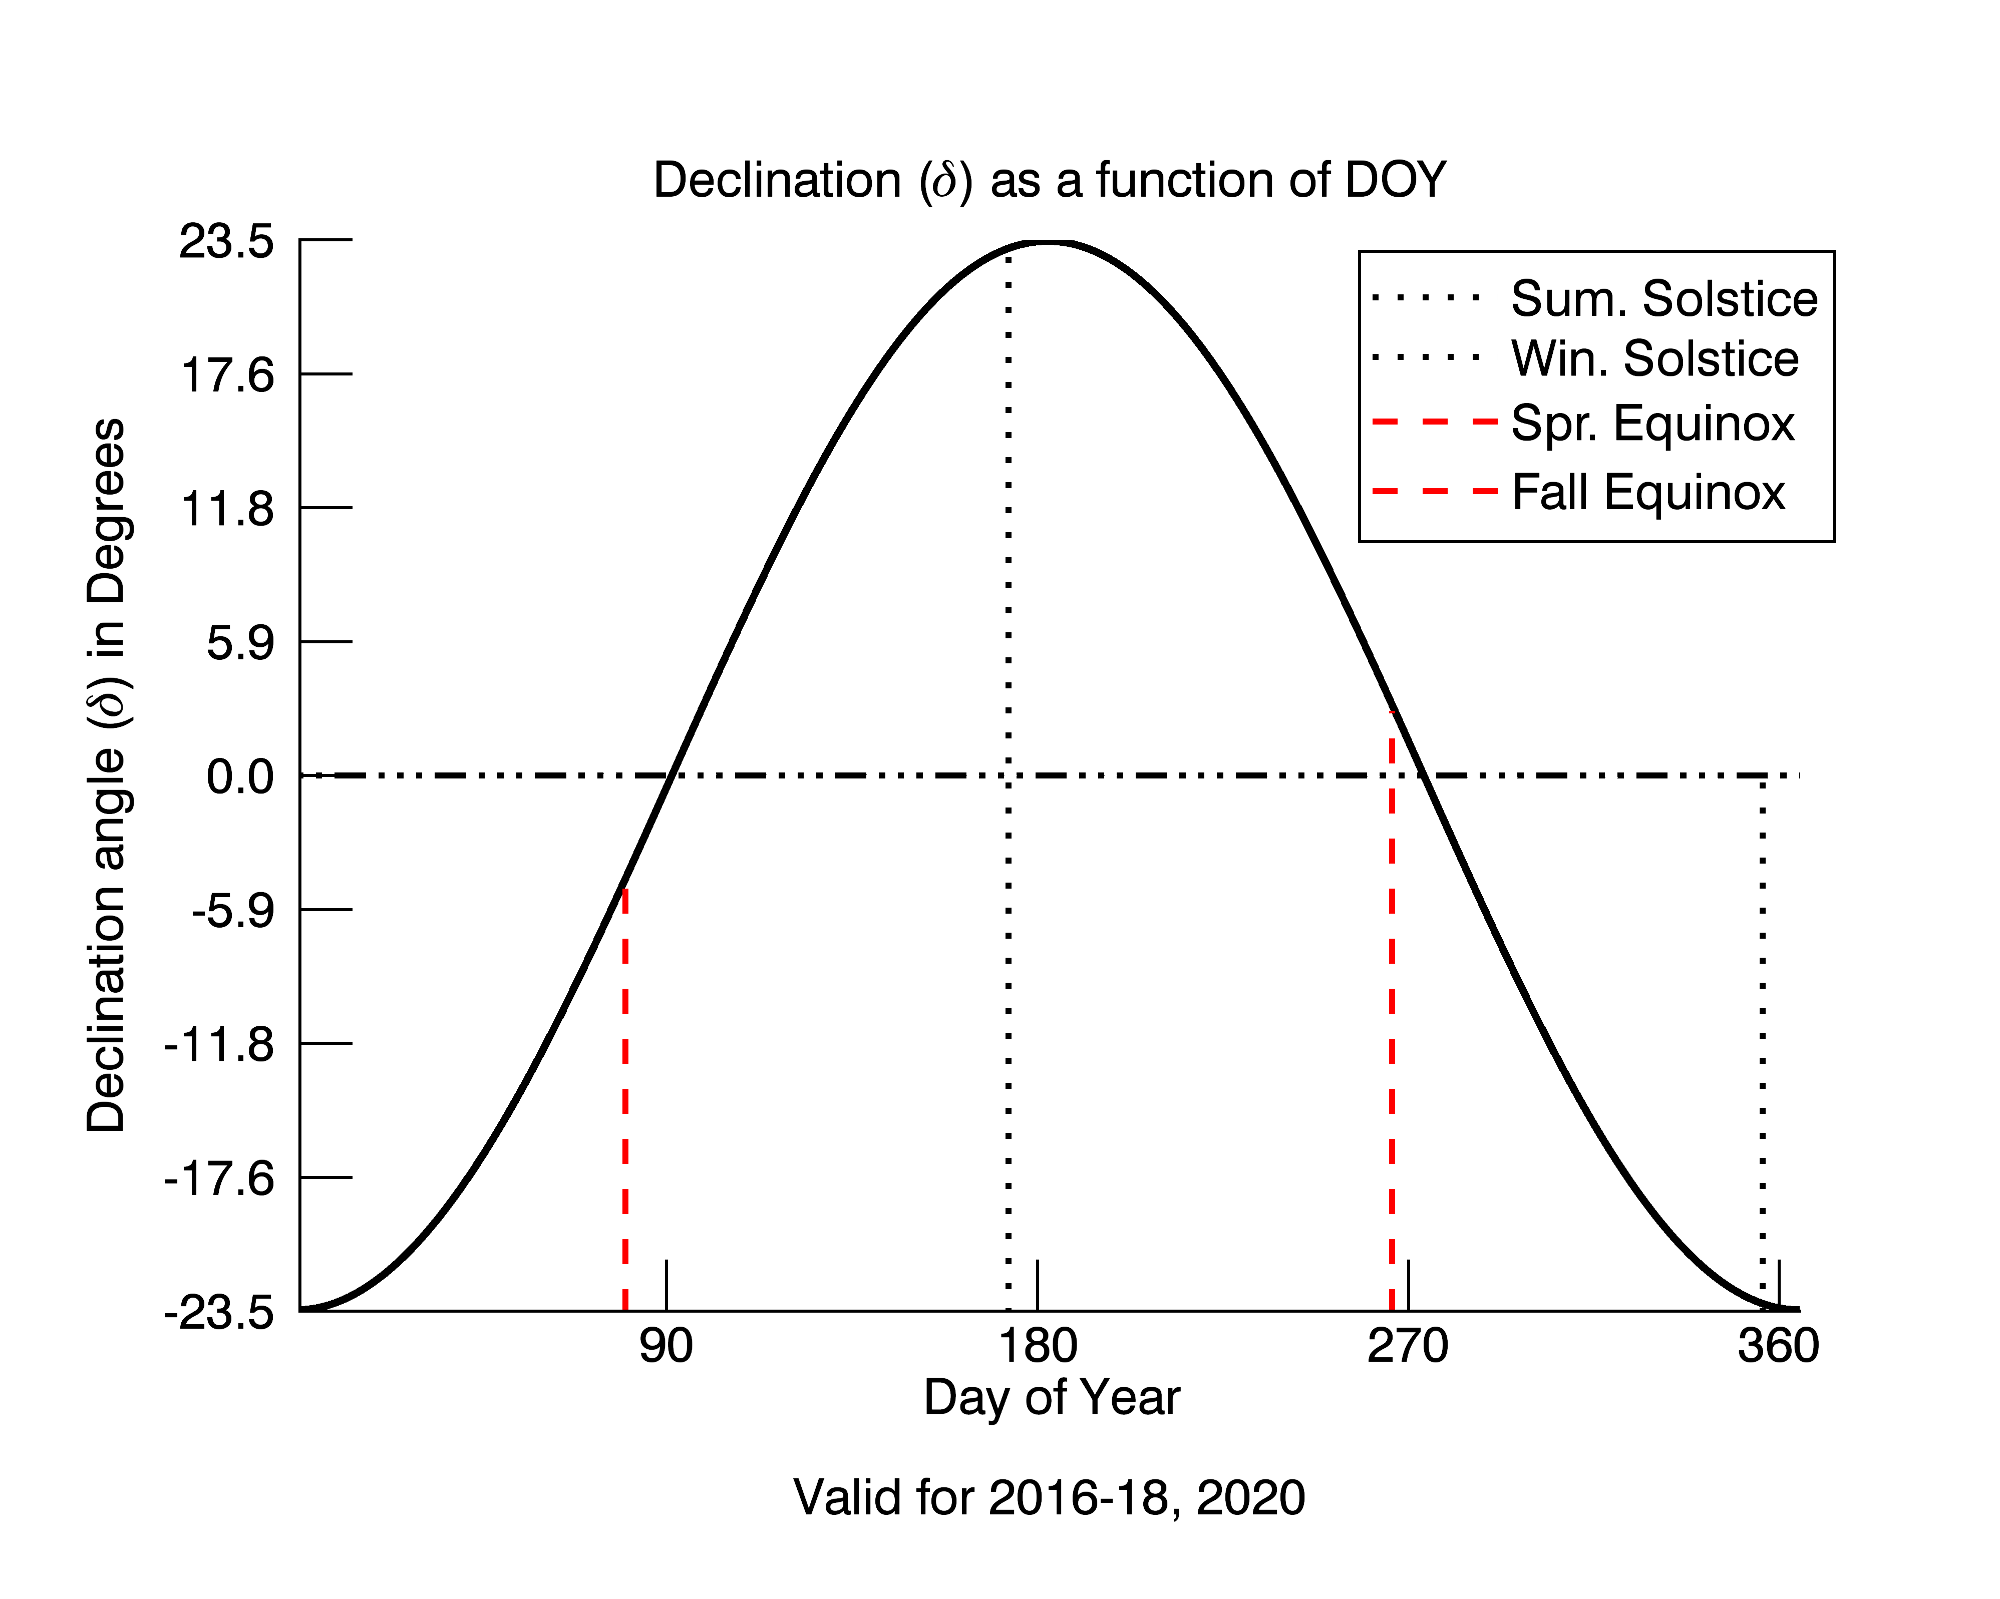
Direct from IDL to EPS
Direct from IDL to PNG

Slide 34
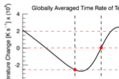
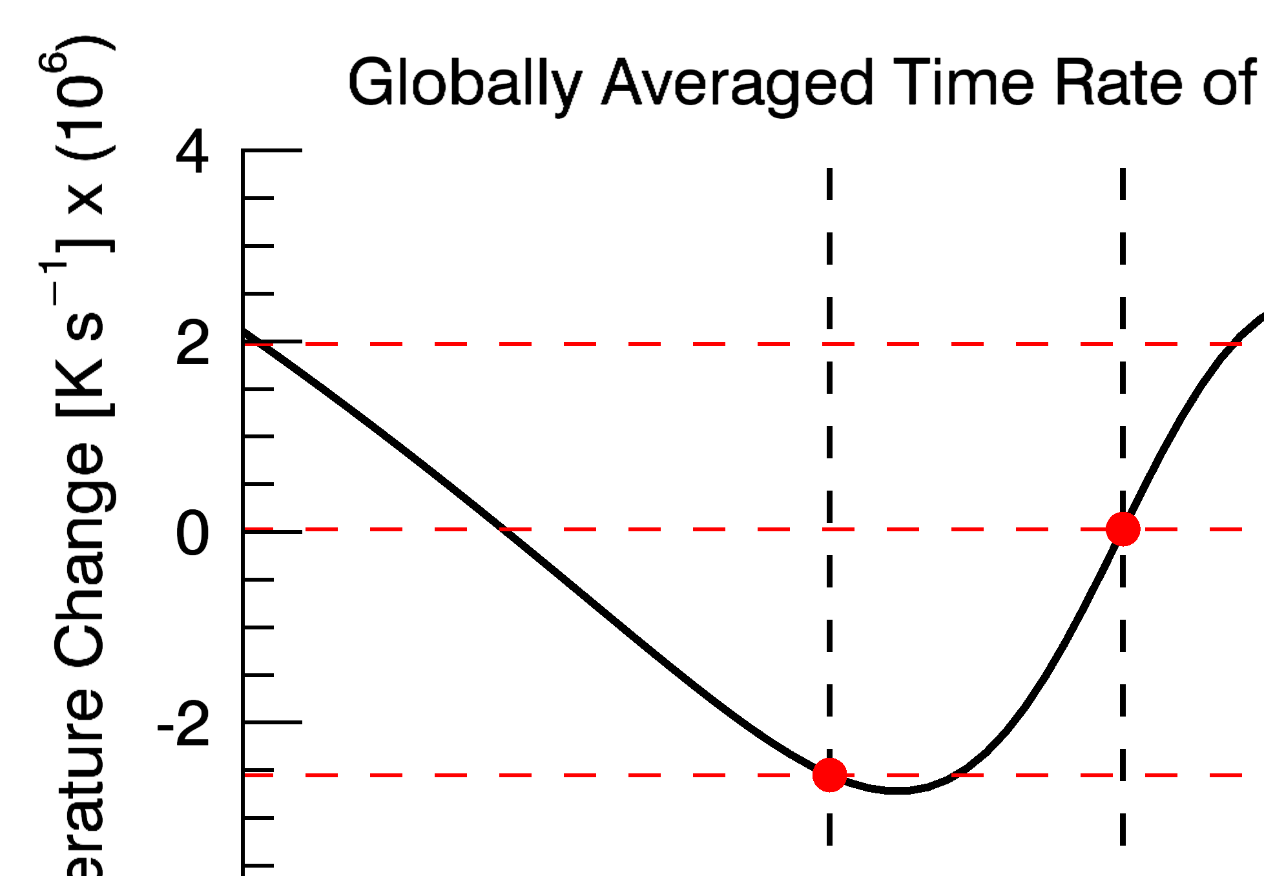
Don’t resize bitmapped images
Notes:
Vector based images prevent this nonsense.

Slide 35
Summary
Good | Bad
Terms are spelled out | Excessive abbreviations to decode
Text runs left to right | Text in vertical or multiple directions
Data is clarified with small notes | Requires repeated references to scattered text
Legends and labels
Axes, curves and markers make sense | Repeated back and forth between legend and graphic required
Graphic attracts viewer | Graphic is repellent, filled with junk
Color choices (blue ‐ good) | Dark letters on dark contrast (Red & green)
Font type is clear, precise, modest | Type is dense, heavy, overbearing
Upper & lower case, with san-serif | All upper case, serifs
Graphics should tend toward the horizontal, greater in length than height

Slide 36
If you cant explain your figure to a middle schooler, then it’s probably too complex.

Slide 37
Questions?
Take an existing figure that you have (or make one) and make it publication ready.

