Slide 1
Atmospheric Sciences 6910
Programming for Environmental Sciences

Slide 2
Syllabus
Tues & Thurs 3:40 – 5:00 in WBB 711
Instructors:
Ryan Bares
Adam Abernathy
Sally Benson
Chris Galli
First 10 minuets of class reviewing readings and homework followed by lecture.
Homework will be available on class website by the start of class.
To turn in homework email your answer / program to the instructor who assigned it.
No Class Thursday November 24th: Thanksgiving Break
Class HTML page at: http://www.inscc.utah.edu/~u0079358/atmos6910/

Slide 3
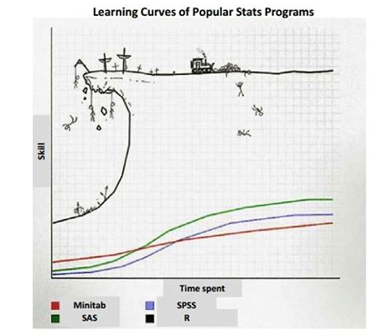
Languages
Environmental sciences is a big field encompassing many different disciplines, employing the use of an array of different analytical practices.
Languages: R, Fortran, Python, Idl, C, ect…
Data Structures: .csv, Netcdf, HDF5
Analytical Methods: Statistical, visual, spatial, time-series
This class will be language agnostic
or neutral. We are assuming
some basic understanding of
coding.

Slide 4
Languages
Each research group will employ different data structures, methods and languages to examine their particular field.
Each language has its benefits and limitations. Some languages have strong communities built around them (R, Python). Open source languages tend to have better communities which can be a real advantage.
Stack Overflow!
Our Goal: to provide you with a background in computer science / programming to help you answer your research objectives in the most powerful and time efficient ways while avoiding common pitfalls.

Slide 5
Workflow
Regardless of which toolsets used, the general flow of each of your projects will follow a similar workflow.
1) Get data
2) Bring data and packages into environment
3) Frist look
4) QA/QC
5) Pair additional data sets
6) Data transformations
7) Sub-setting / isolating data
8) Analysis
9) Plotting / data visualization
10) Final results

Slide 6
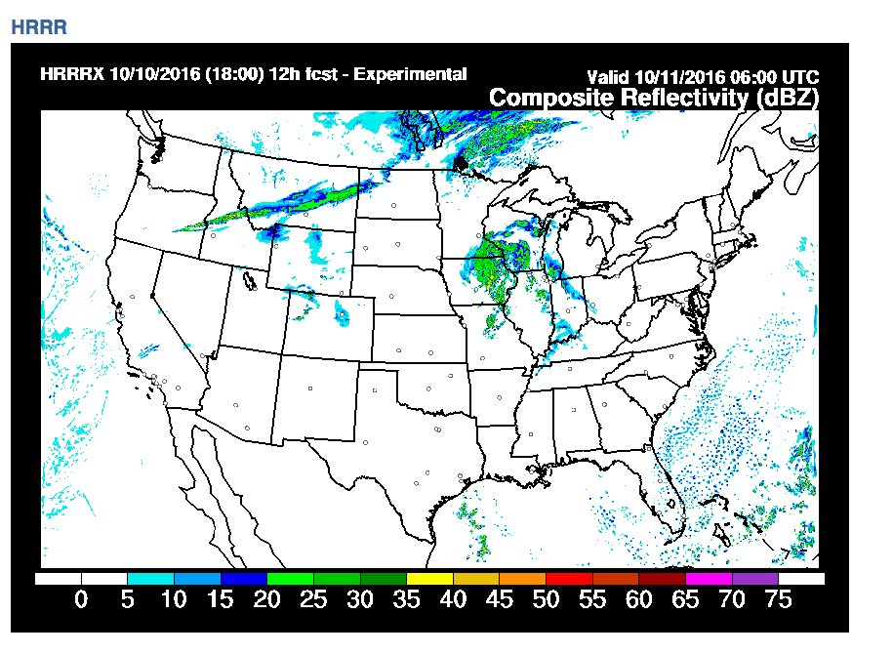
Workflow: Data
Step 1: Get your data
Data API’s
Measurements
Laboratory Experiments
Understand your data
Products vs. Measurements
Expectations (freq., sensitivity)
Data Quality
Accuracy and Precision
Data Type
Where to store the data?
CHPC, personal computer,
other server

Slide 7
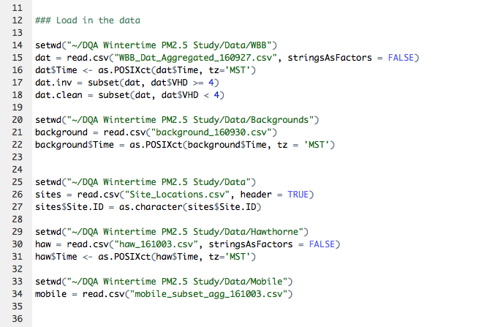
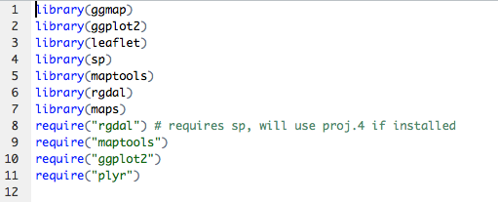
Workflow: Data In
Step 2: Get the data into an environment
Load necessary packages

Slide 8
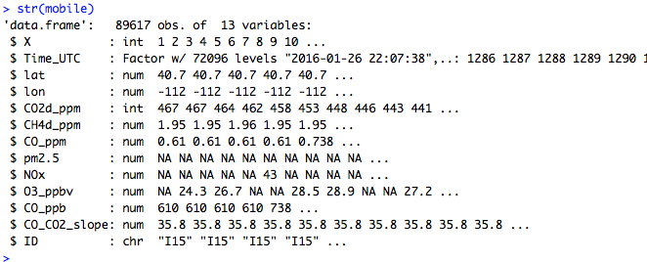
Workflow: First Look
Step 3: First look
Headers
Data structure
Variables
Data types
Data frequency

Slide 9
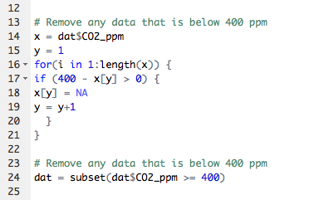
Workflow: QA/QC
Step 4: QA/QC the data
Visual / Interactive
Plot the data and visually identify problematic areas
Limited to smaller datasets and can be subjective
http://www.inscc.utah.edu/~u0079358/atmos6910/Class_1/qaqc.html
Statistical / Mathematical
STDEV, > or <, y-x, smoothing, quintiles
Great for large data sets and automated scripts but can miss complex problems and can remove valid data
Pre-define data levels
Raw, qa/qc, final

Slide 10
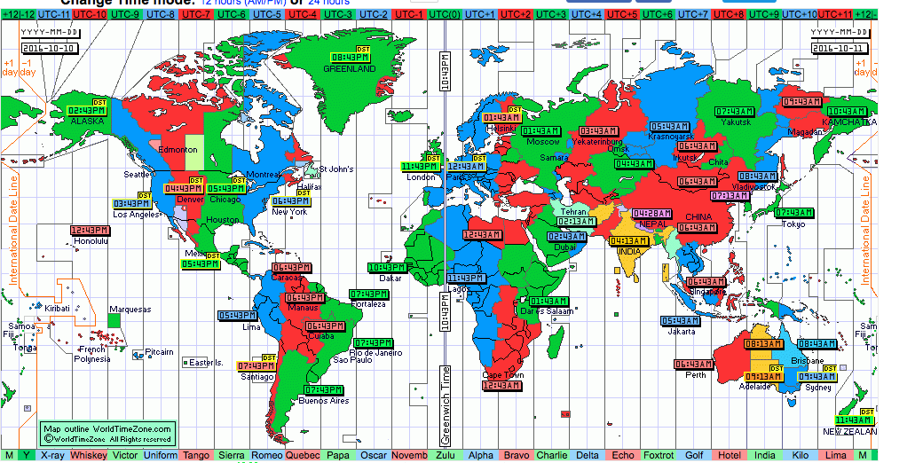
Workflow: Pairing Additional Data
Step 5: Pair additional datasets
Repeat steps 1:4 and make sure to QC/QC new data before pairing!!!
Matching variable
Common time stamps / gridded location
Matching data frequencies
Double check that the matching variables line up….
Pay attention to time zones

Slide 11
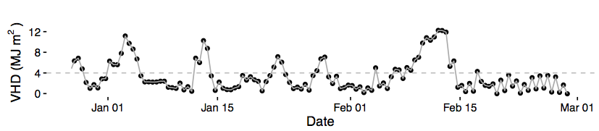
Workflow: Data Transformations
Step 6: Data Transformations
Unit Conversions
Data Type Changes
as.numeric(), as.POSIXct(), as.boolean()
Calculations
Interpolations
Averages

Slide 12
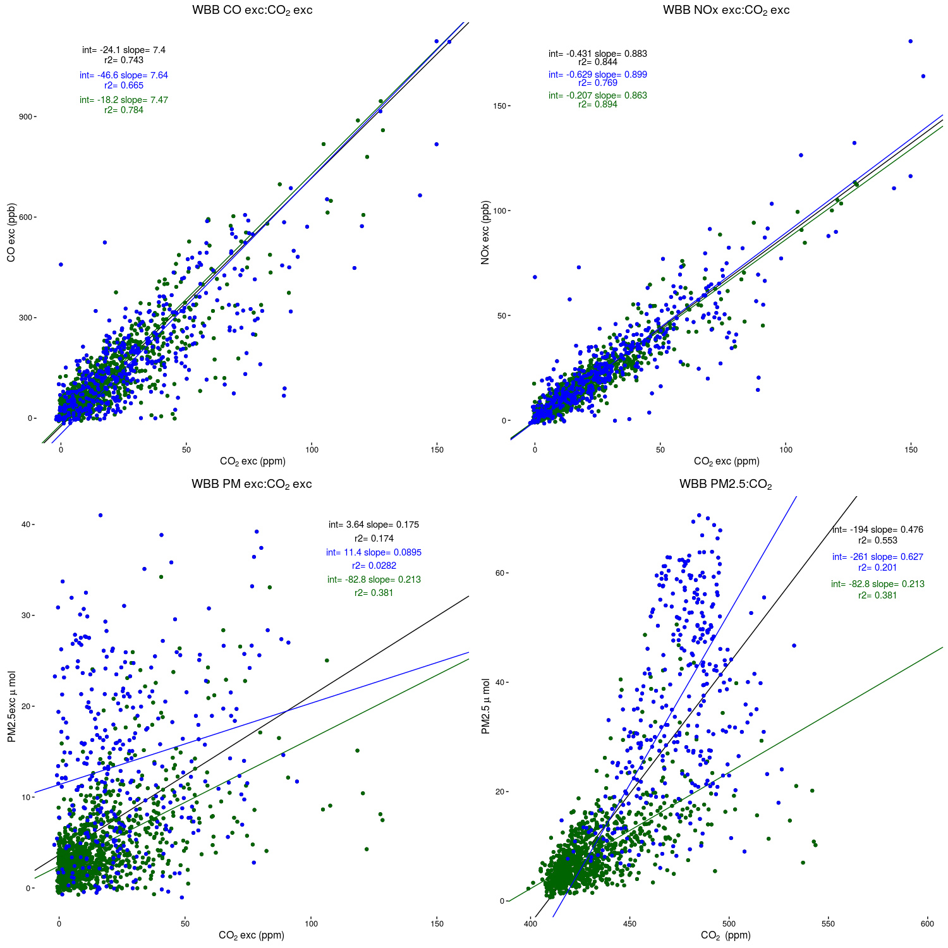
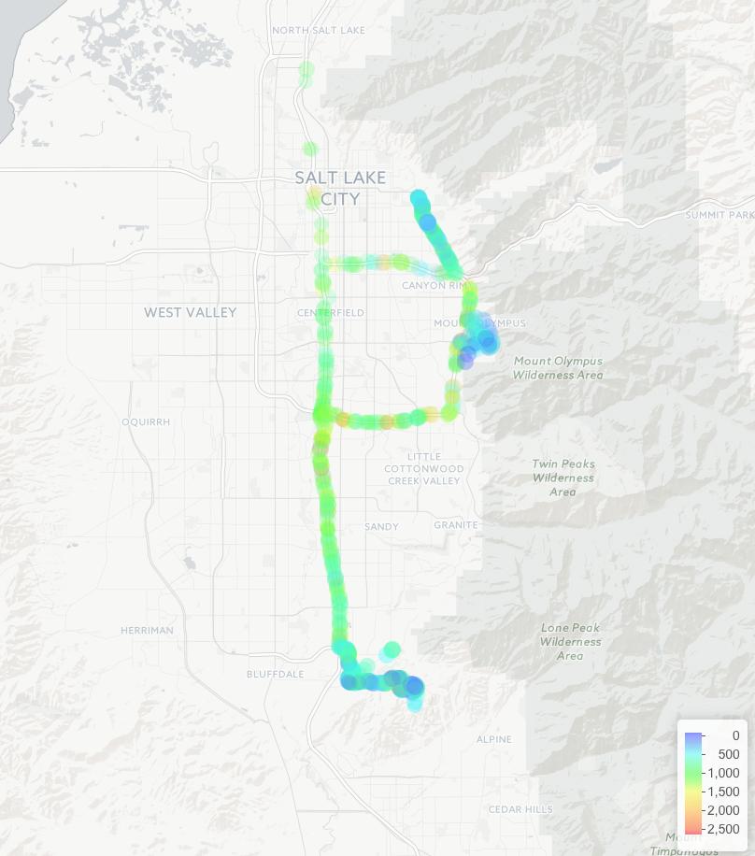
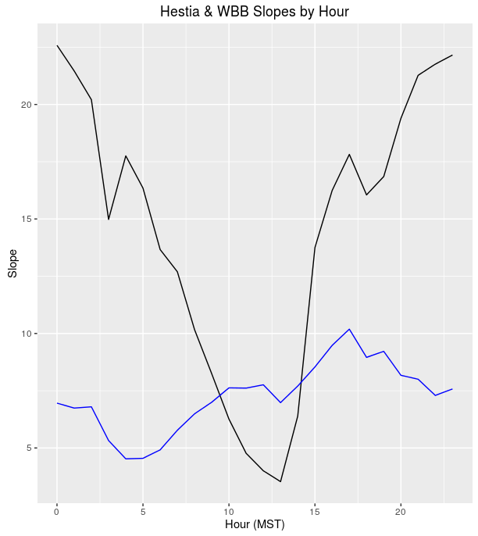
Workflow: Analysis
Step 7: Analysis
Statistical
Spatial
Validation

Slide 13
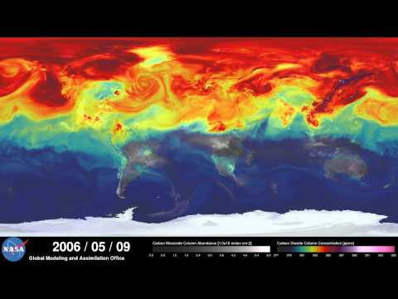
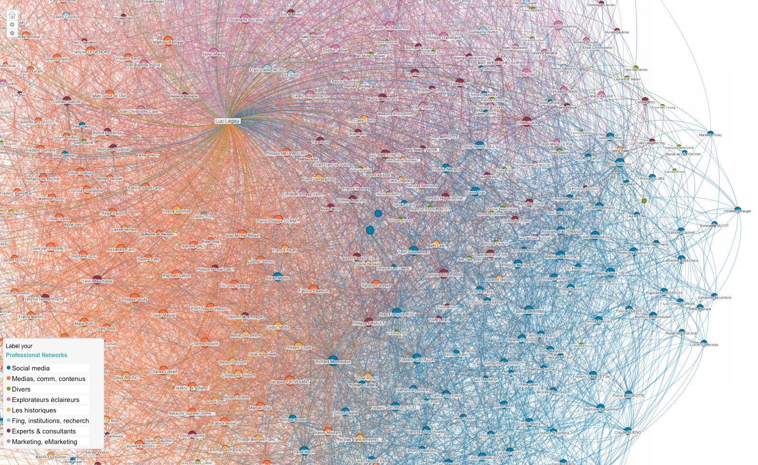
Workflow: Visualization
Step 8: Data Visualization / Plotting
https://www.youtube.com/watch?v=x1SgmFa0r04

Slide 14
Workflow: Final Results
Step 9: Final Results
Science is a never ending redefining of the knowledge we currently have.
A good analysis will identify more questions than it will answer.
Repeat steps 1 – 8…
Publish or perish!

Slide 15
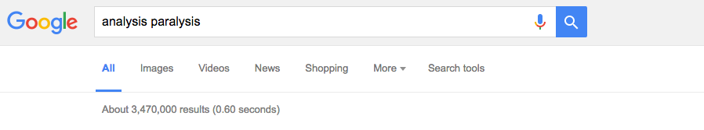
Analysis Paralysis
The prospect of taking on a multi-year research project can be overwhelming at times. There are so many decisions to be made and obstacles to overcome.
It is easy to fall in to analysis paralysis, or a “state of over-analyzing (over-thinking) a situation so that a decision or action is never taken, in effect paralyzing the outcome”.

Slide 16
Overcoming Analysis Paralysis
Differentiate between big and small decisions
Small
Mid-level
Big
Identify your objectives. And remember to re-analyze your objectives as new knowledge is gained
Perfection is not the goal.
“Perfection is the enemy of good enough” – Jim Ehleringer
Eliminate the bad options
Pick one and go. Don’t second guess
Set a hard time limit! Deadlines are the key to preventing procrastination

Slide 17
Overcoming Analysis Paralysis
Delegate the decision to someone else
Your advisors are there for a reasons… to advise you
Get the opinion of someone you trust
Other gradstudents have been there before. Ask them!
Make to do lists.
There is something incredibly powerful about writing down an objective then crossing it off. Take your larger objective and break it down into smaller, yet actionable events.
Don’t go down the rabbit hole. “Curb your curiosity”.
The moons will never be perfectly aligned.

Slide 18
Readings and Homework
http://www.inscc.utah.edu/~u0079358/atmos6910/Class_1
Homework: Download word file from class webpage. Follow instructions and email results to Ryan.Bares@utah.edu
Readings: No formal readings for this week, but I want you to spend time thinking about the languages and environments you currently employ and explore online resources.

